Slide 1





Lesson 0: Hello Scratch

Slide 2
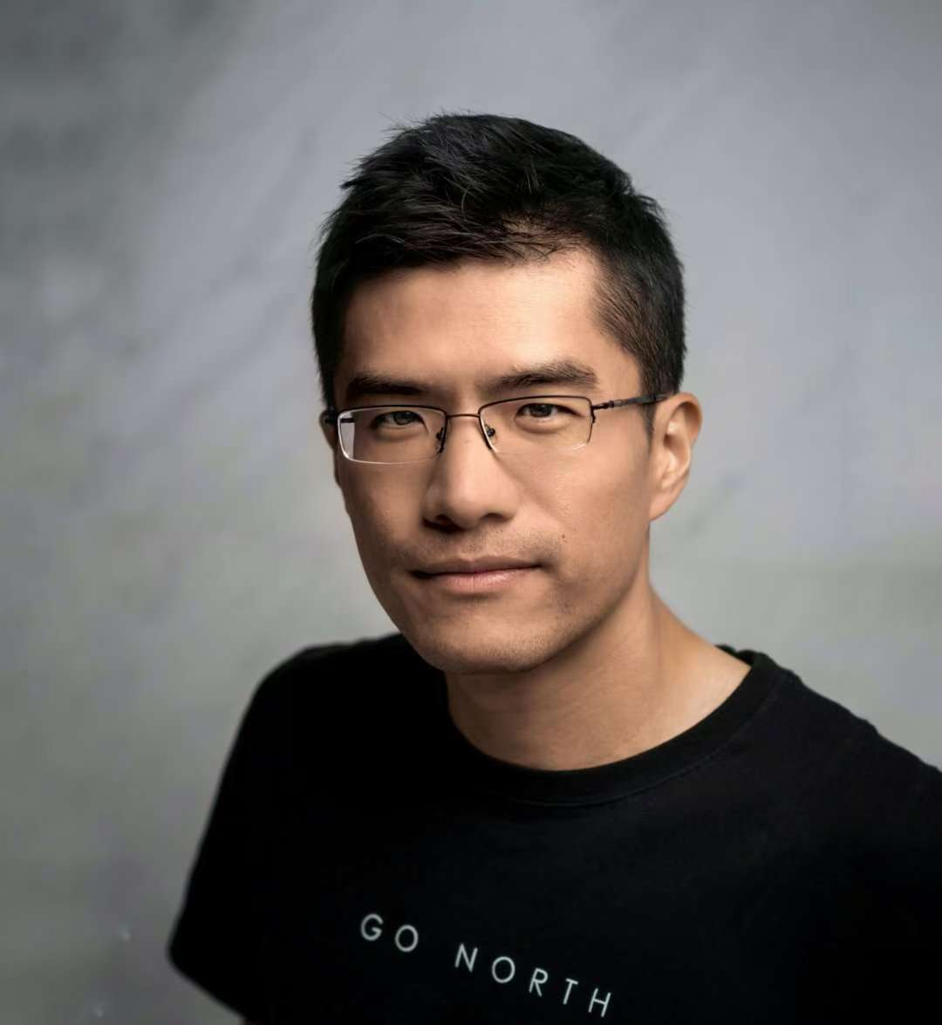
Who Am I?
My name is Jing Guo
PhD in Computer Science
Lived and Studied in the UK for 15 years
Work for the Top FinTech Company
Founder of CoderLand

Slide 3

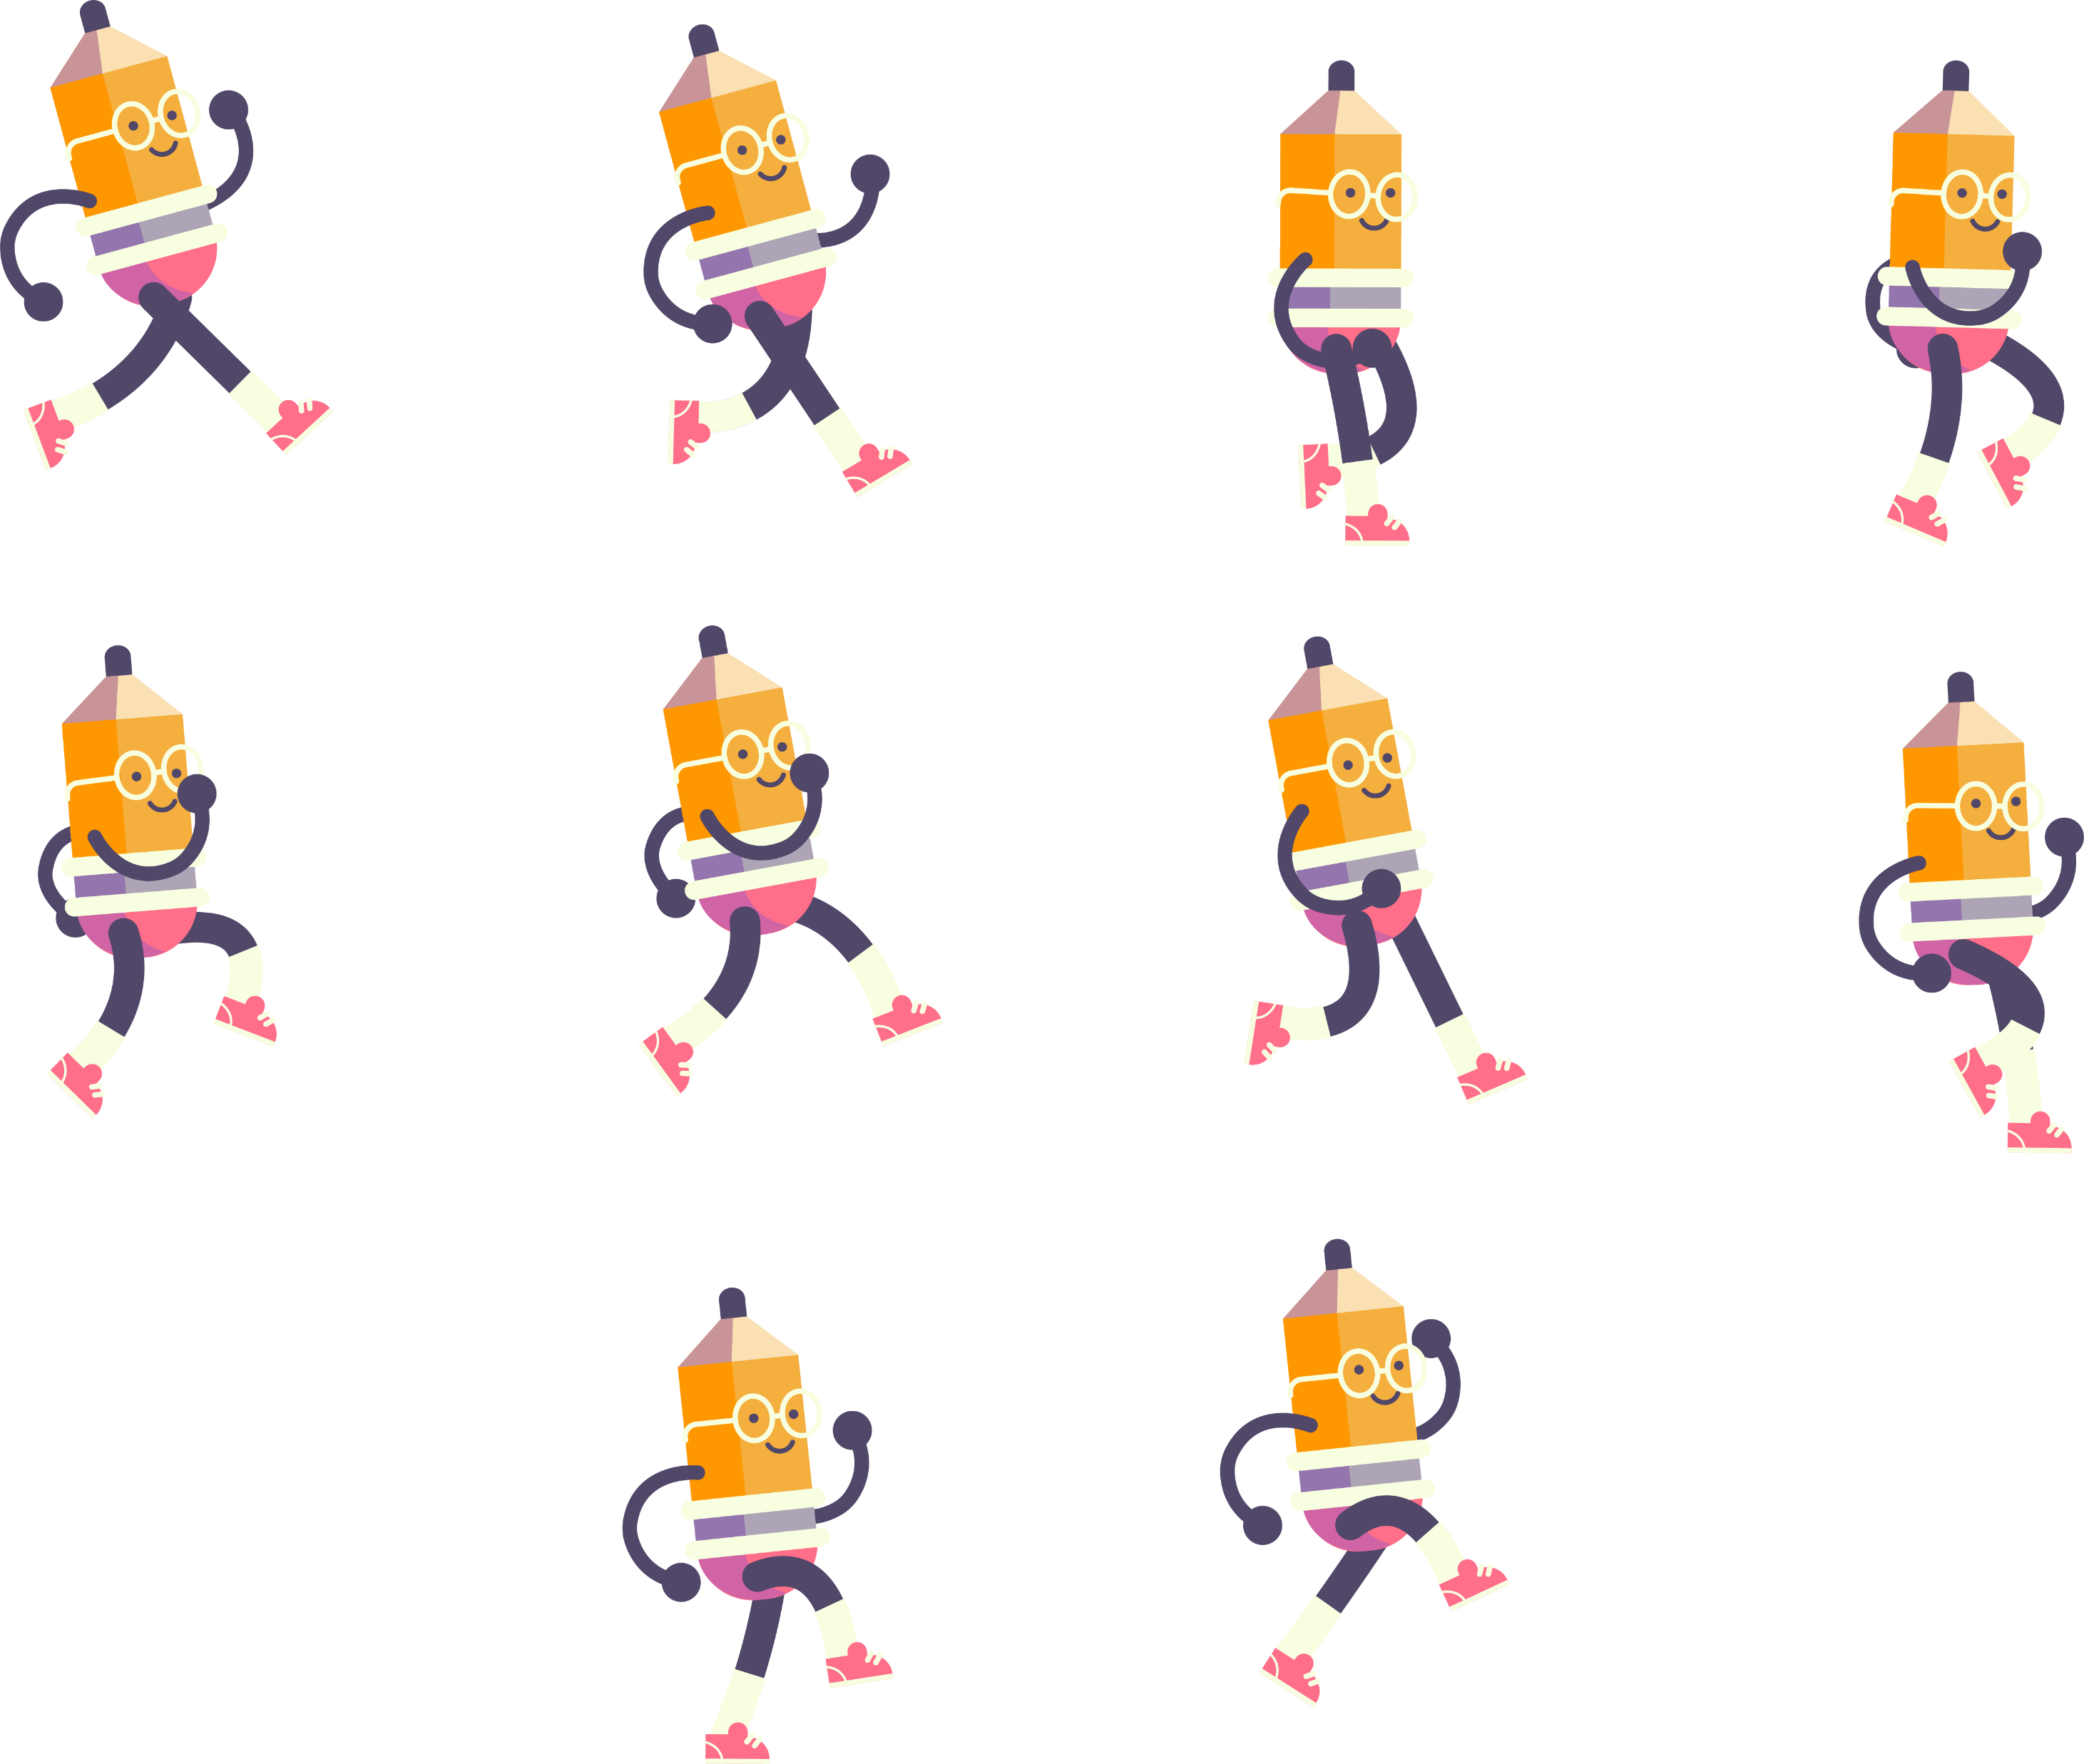

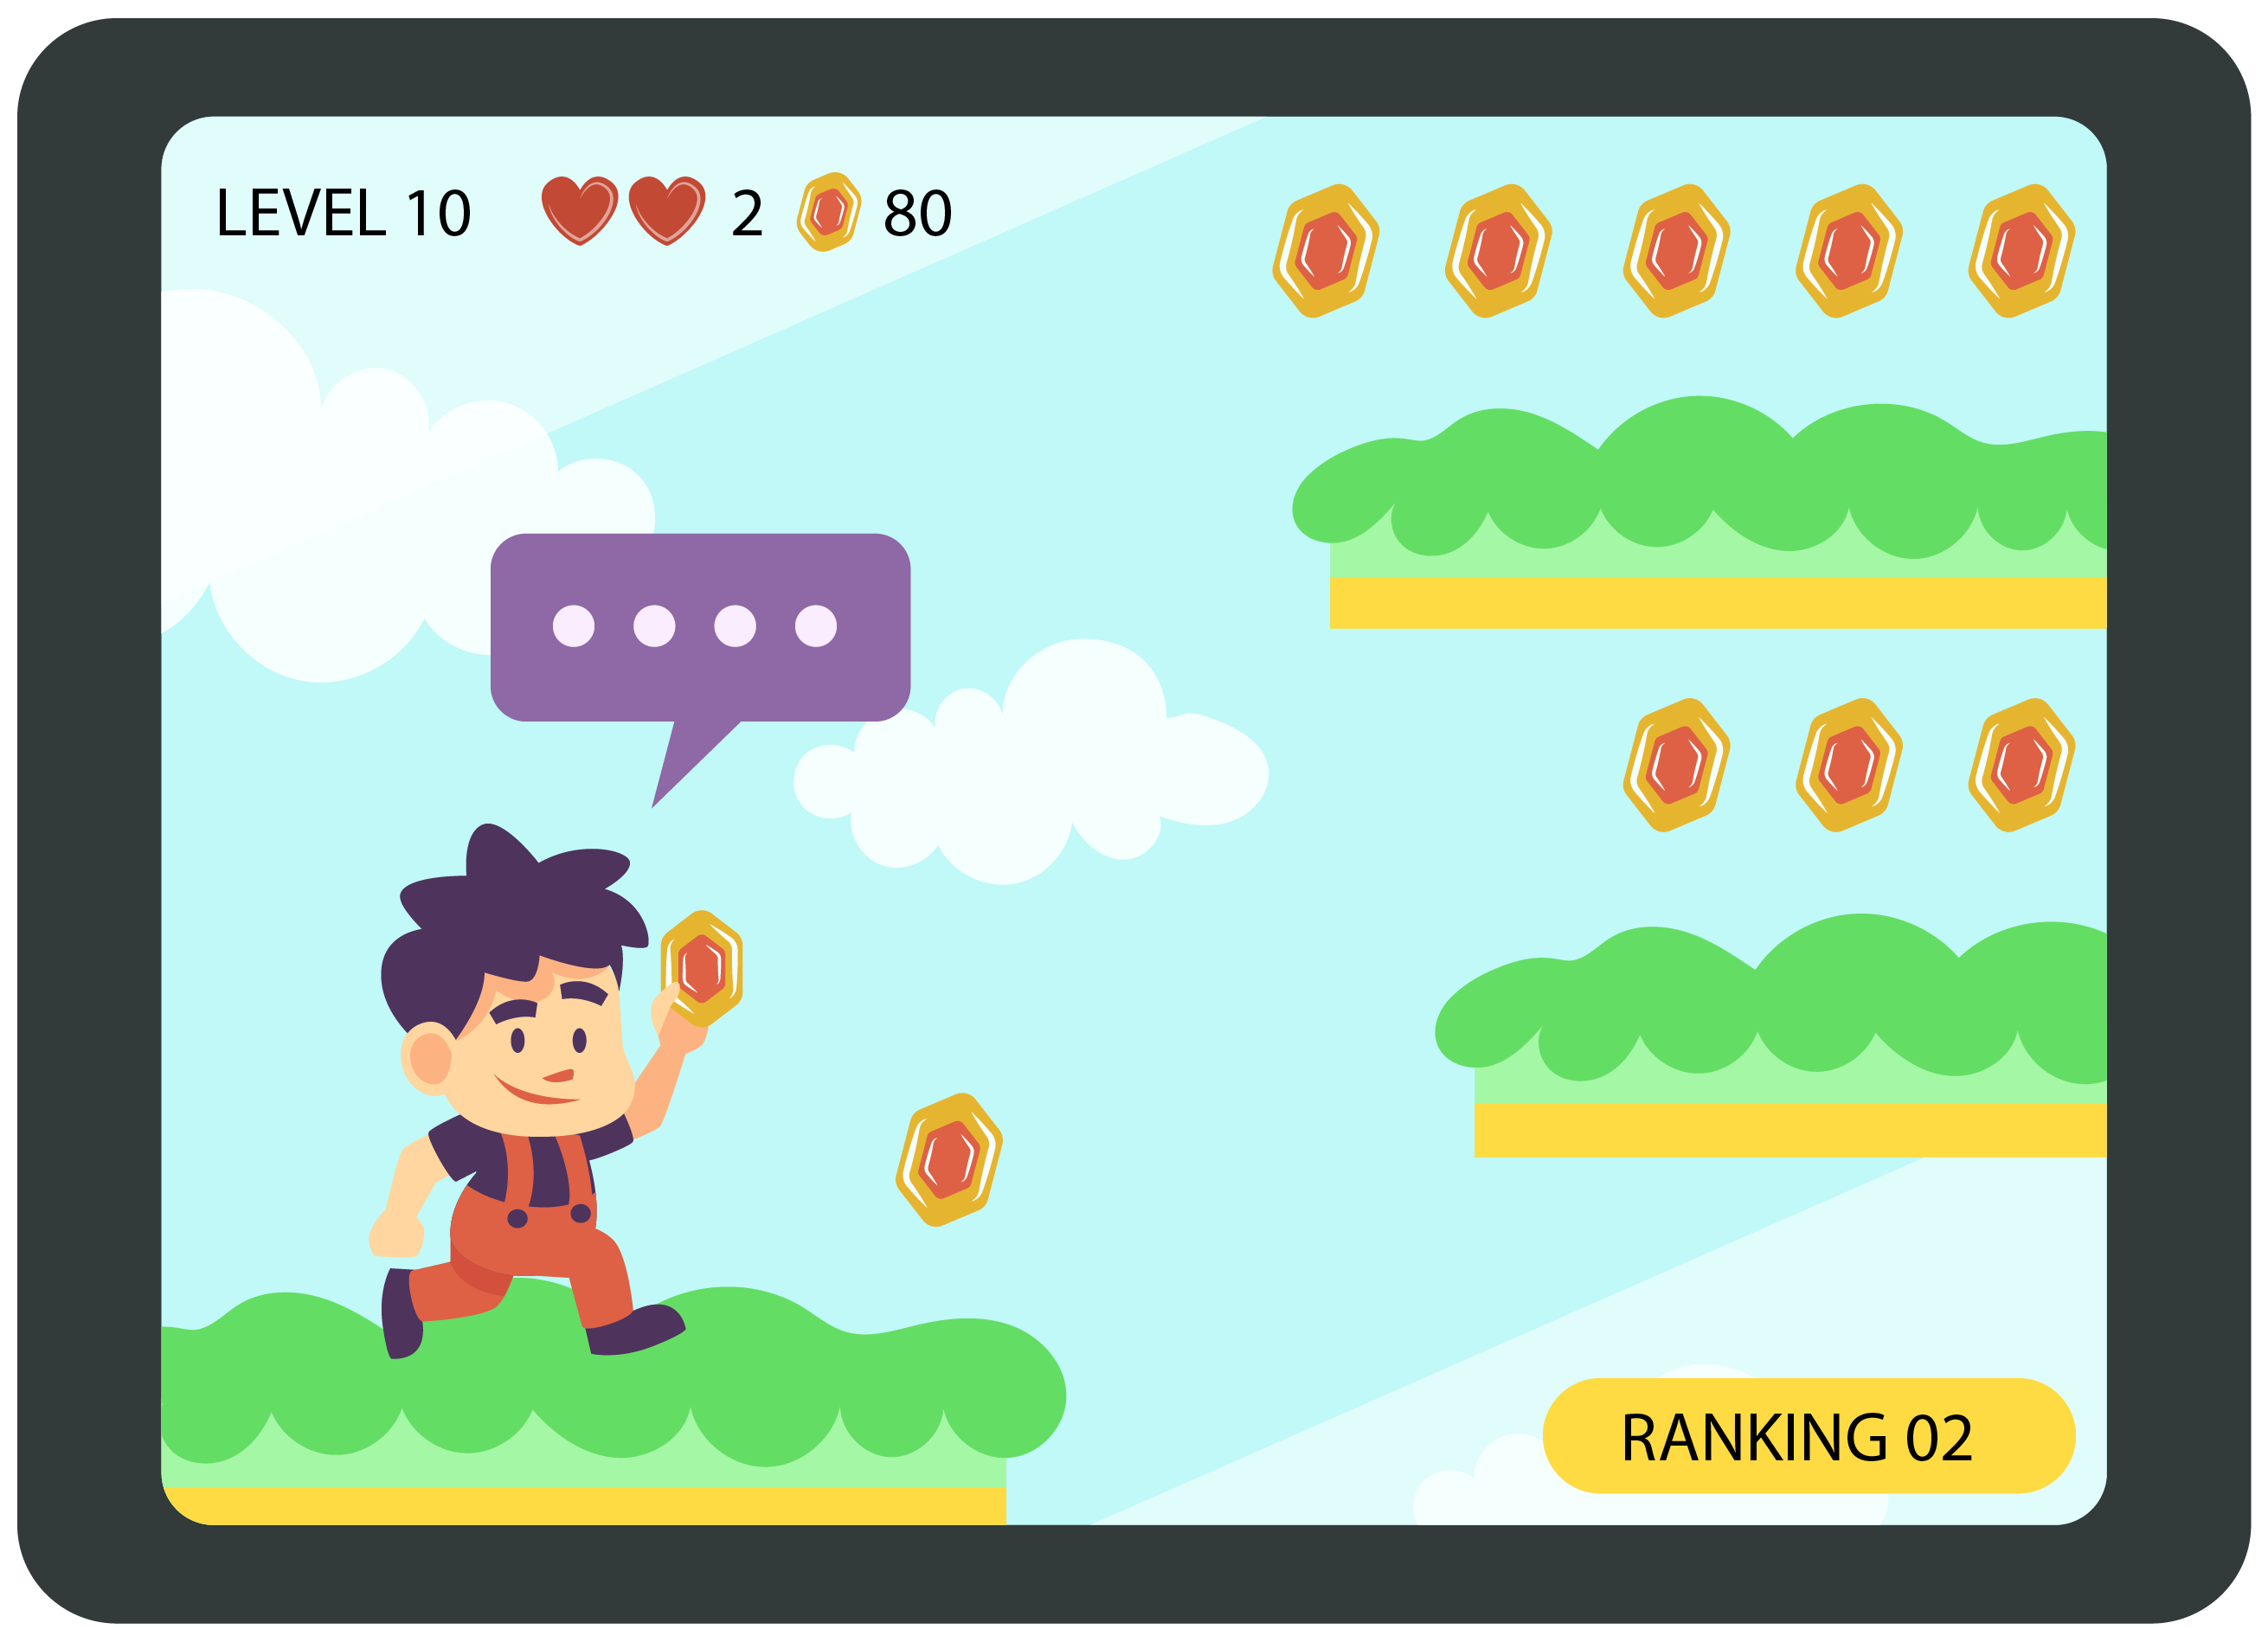
What is this Course About?
Simulations
Animations
Games

Slide 4

Human Languages

Slide 5
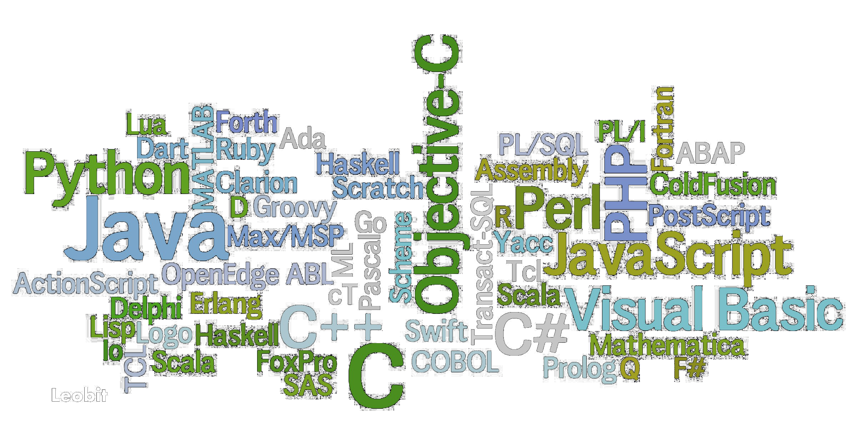
Computer Languages

Slide 6
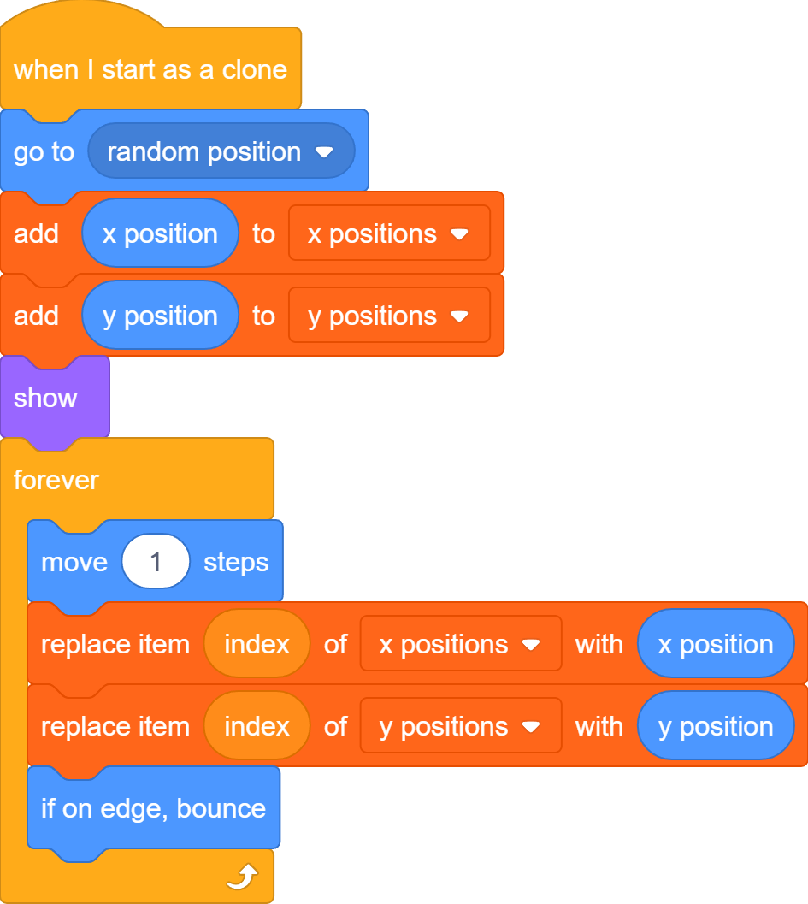

Computer Programs
Or

Slide 7


Meet Scratch

Slide 8
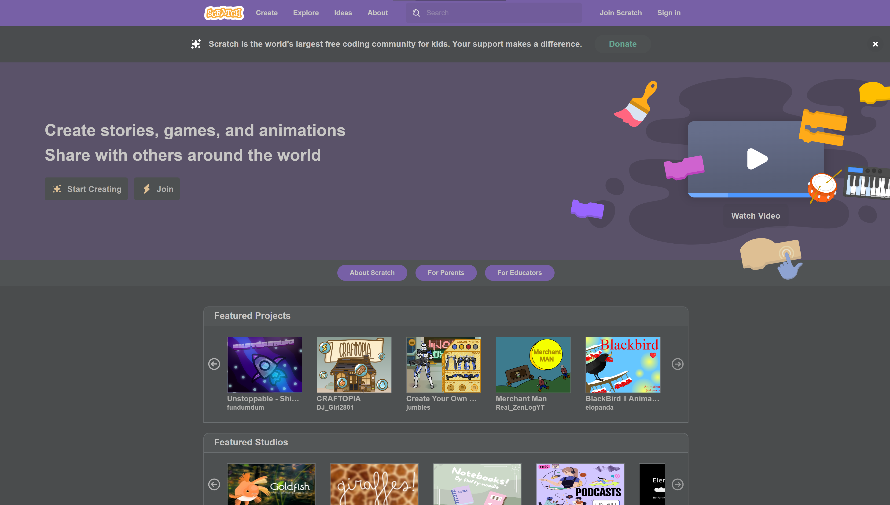
Communities – Official Scratch
scratch.mit.edu

Slide 9
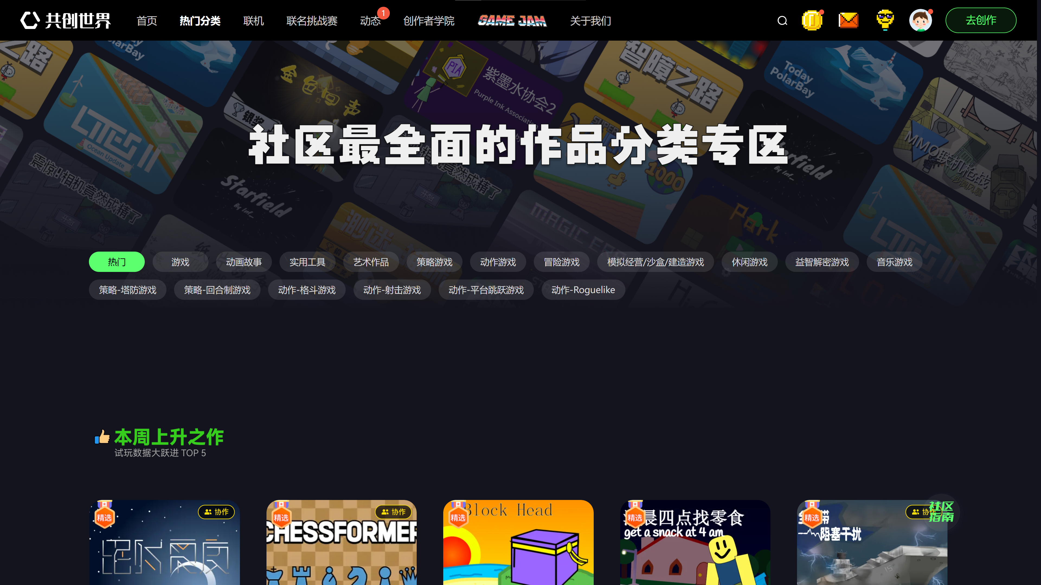
Communities – CoCreate World
www.ccw.site

Slide 10
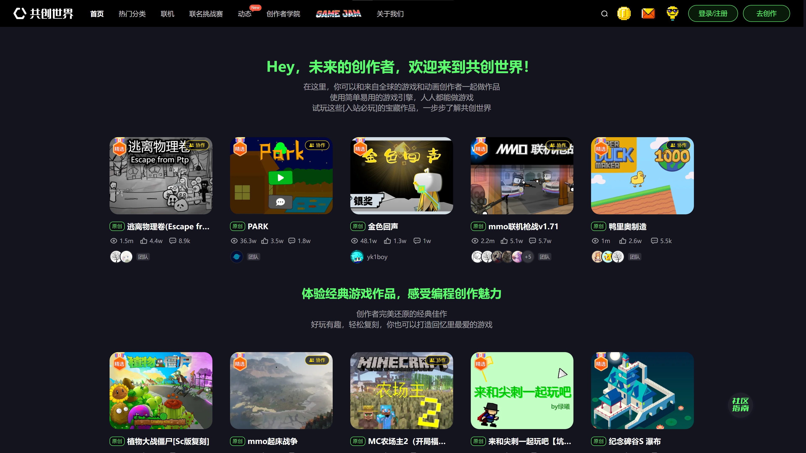

CCW – Login/Register
Login/Register

Slide 11
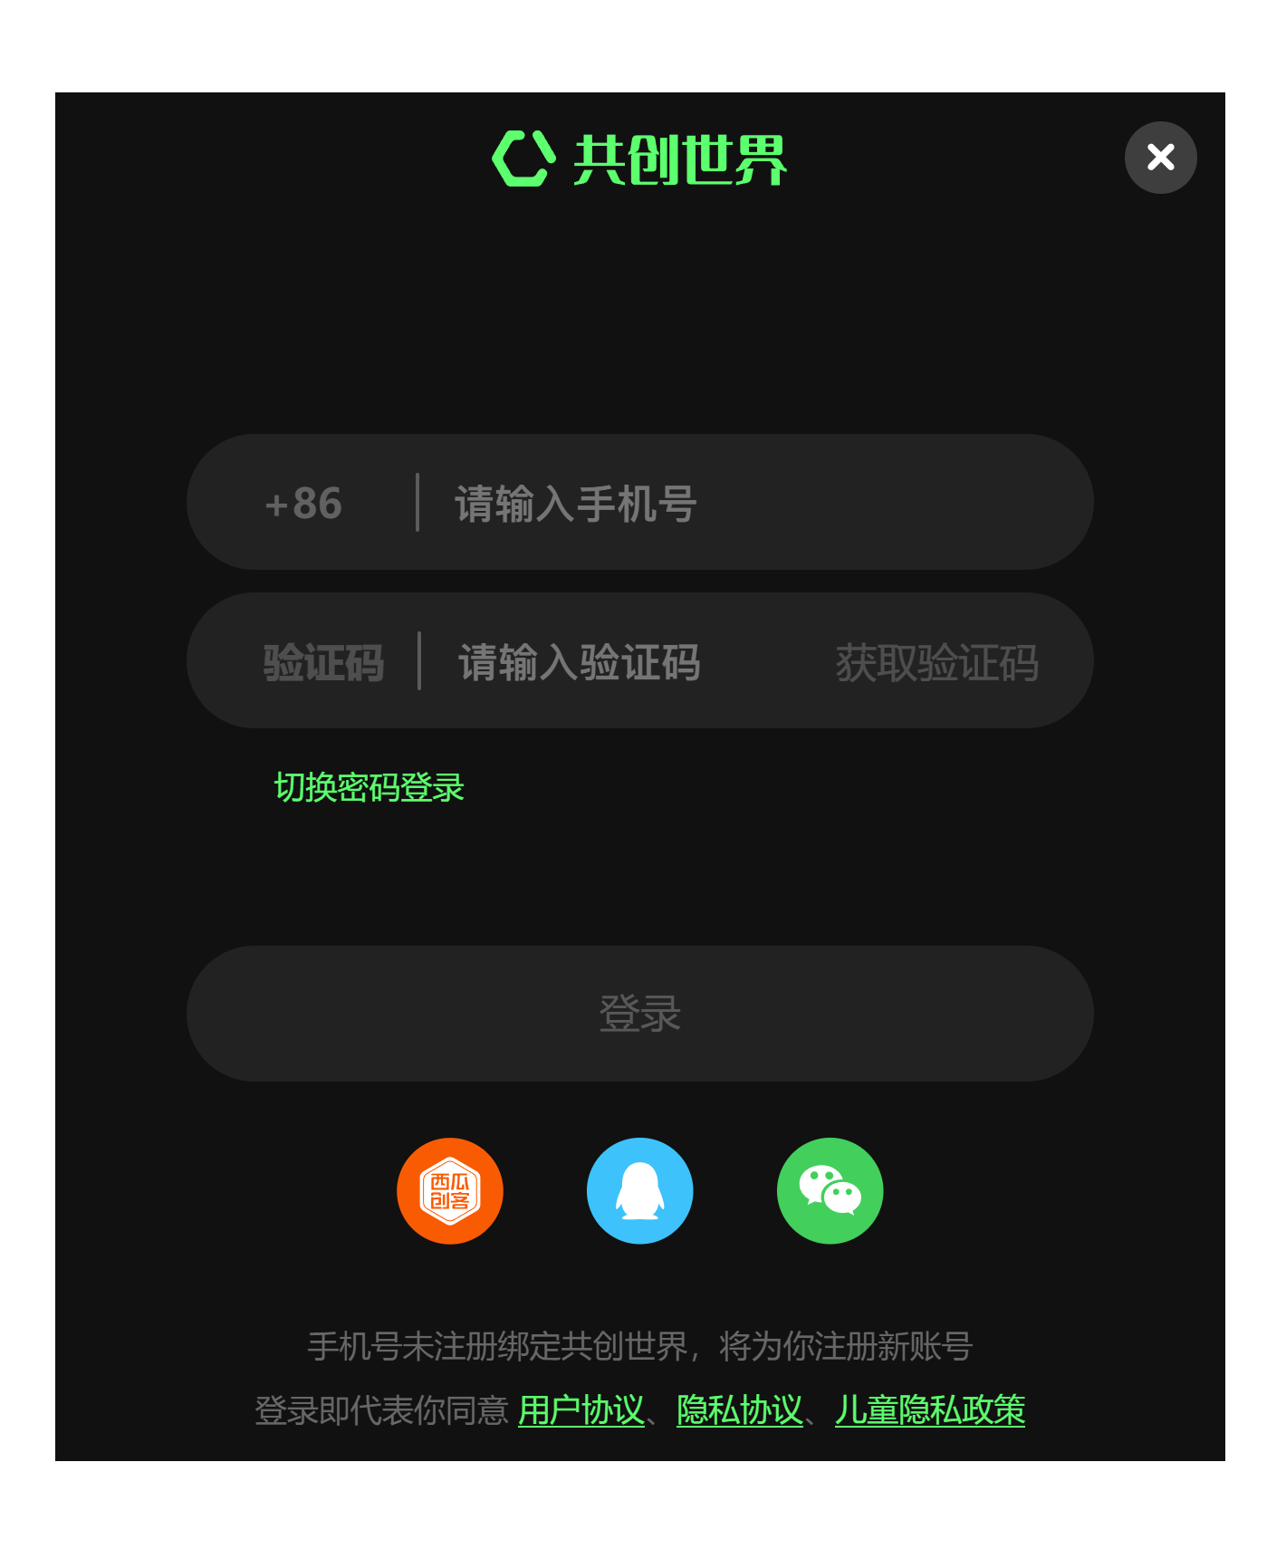
CCW – Login/Register
Phone Number
Verification Code

Slide 12
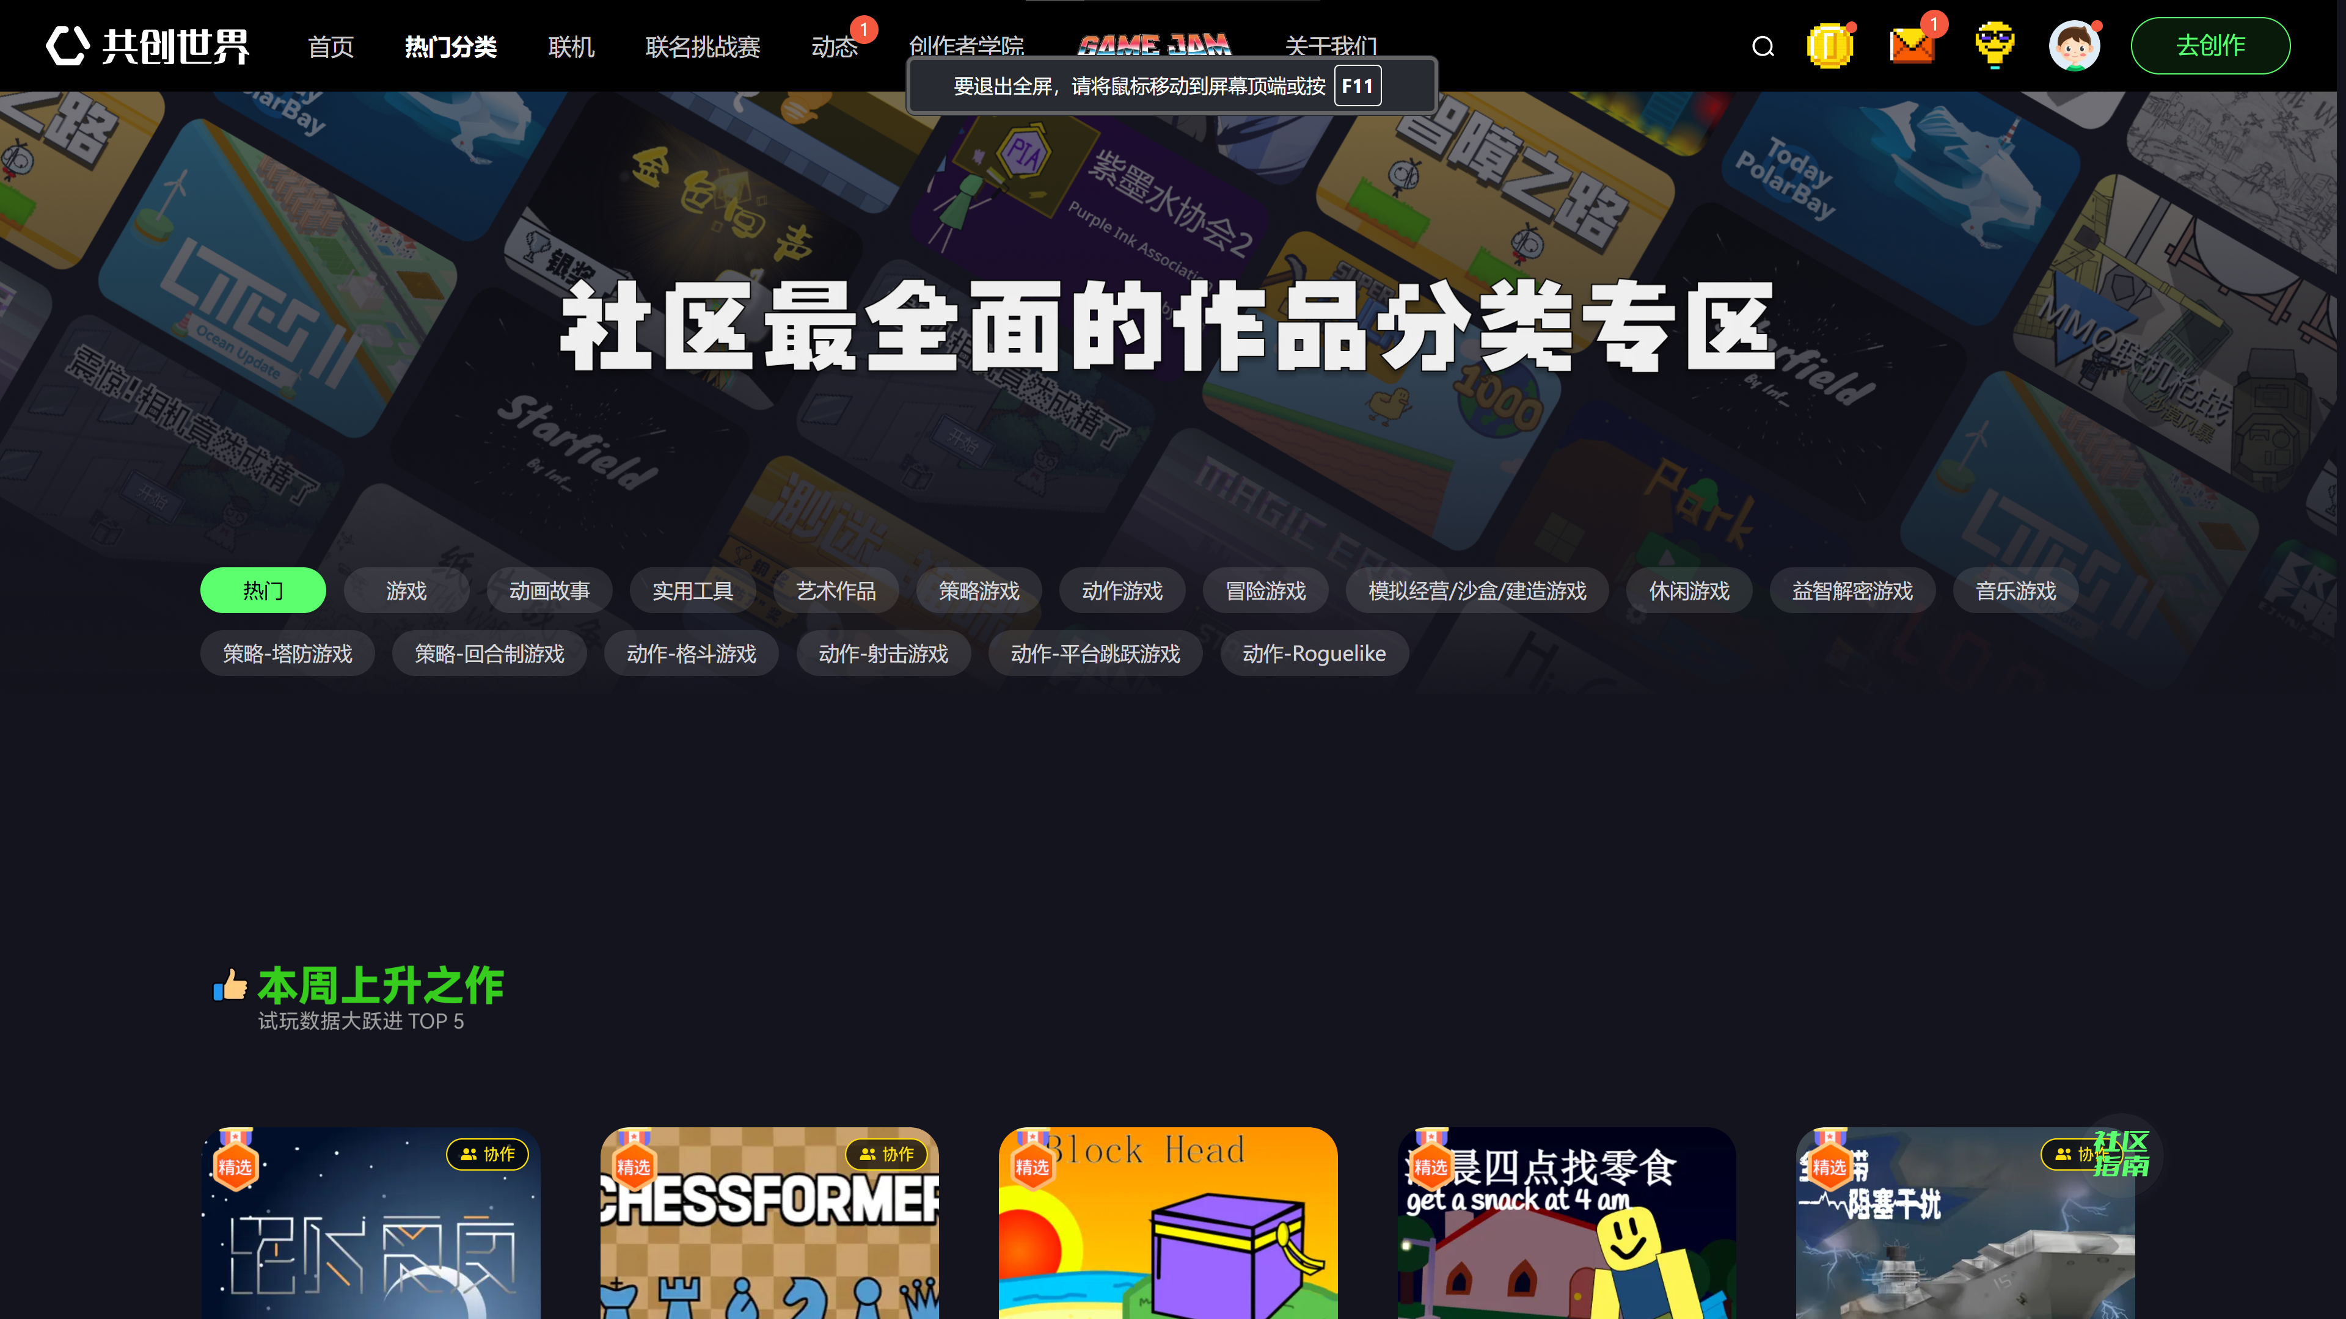

CCW – Messages
Messages

Slide 13

CCW – Creator Center
Creator Center

Slide 14
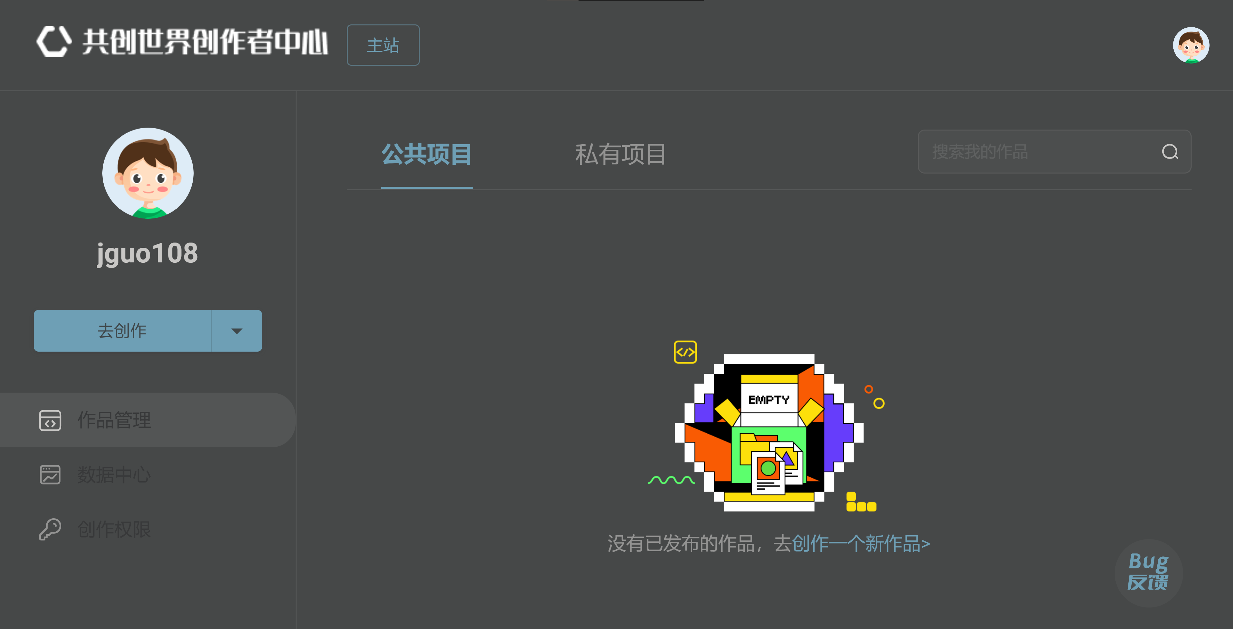
CCW – Creator Center
Public
Projects
Private
Projects

Slide 15

CCW – Go Create
Go Create

Slide 16
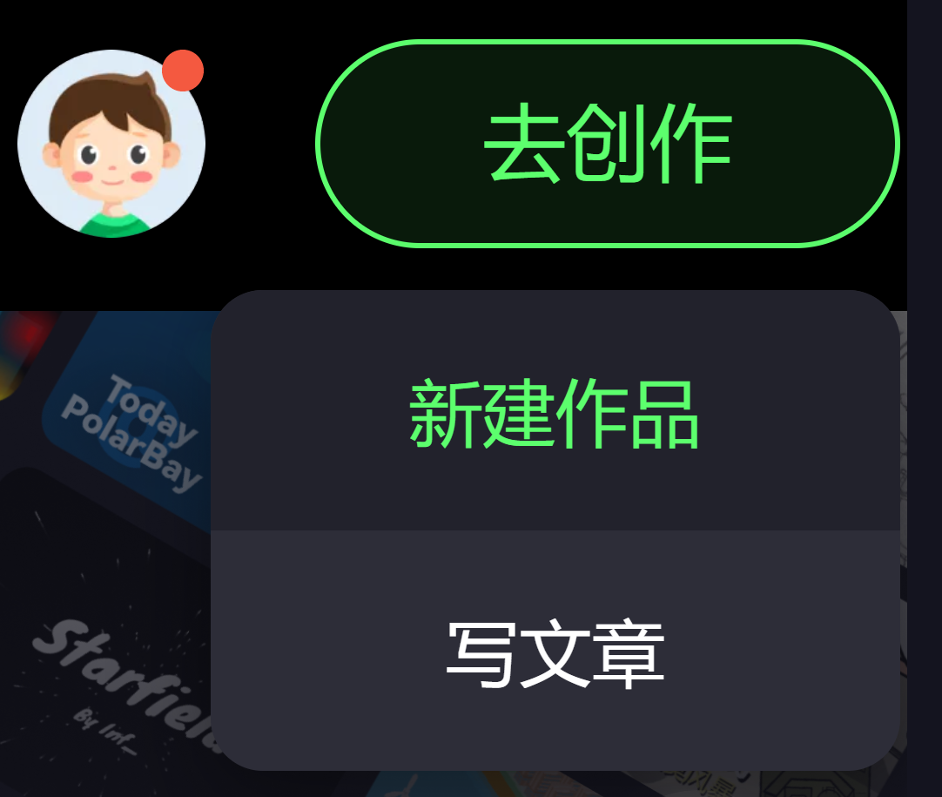
CCW –Create New project
Create New Project

Slide 17
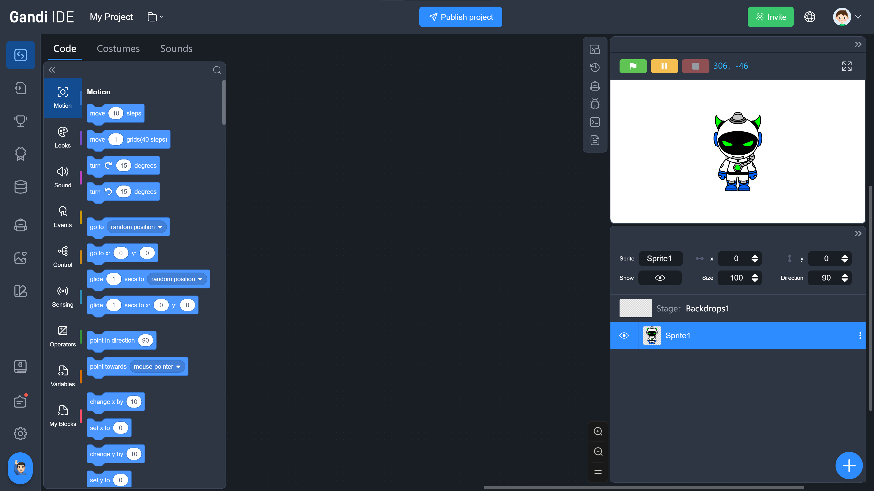
Gandi IDE

Slide 18
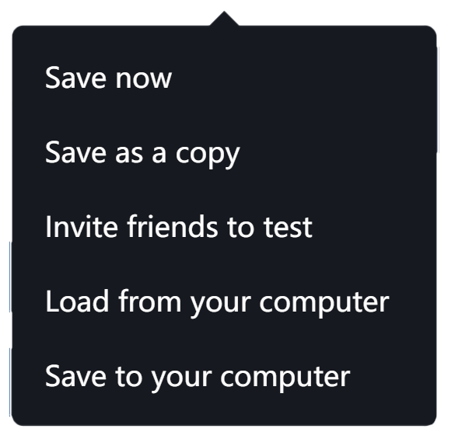
Gandi IDE – top menu
Save Project
Logo
Project Name

Slide 19
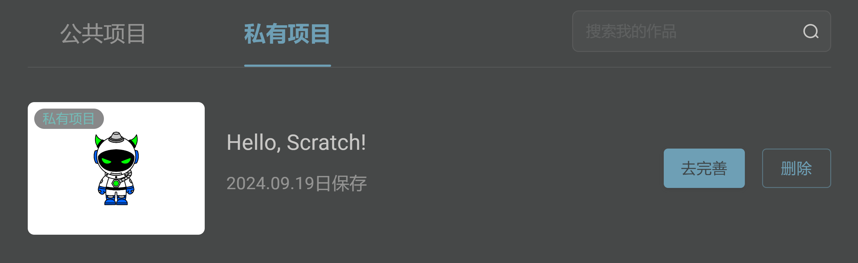
Gandi IDE – SaveD Project
Go Perfect
New Private Project
Delete

Slide 20
Gandi IDE – Publish Project
Turn Project from Private to Public

Slide 21
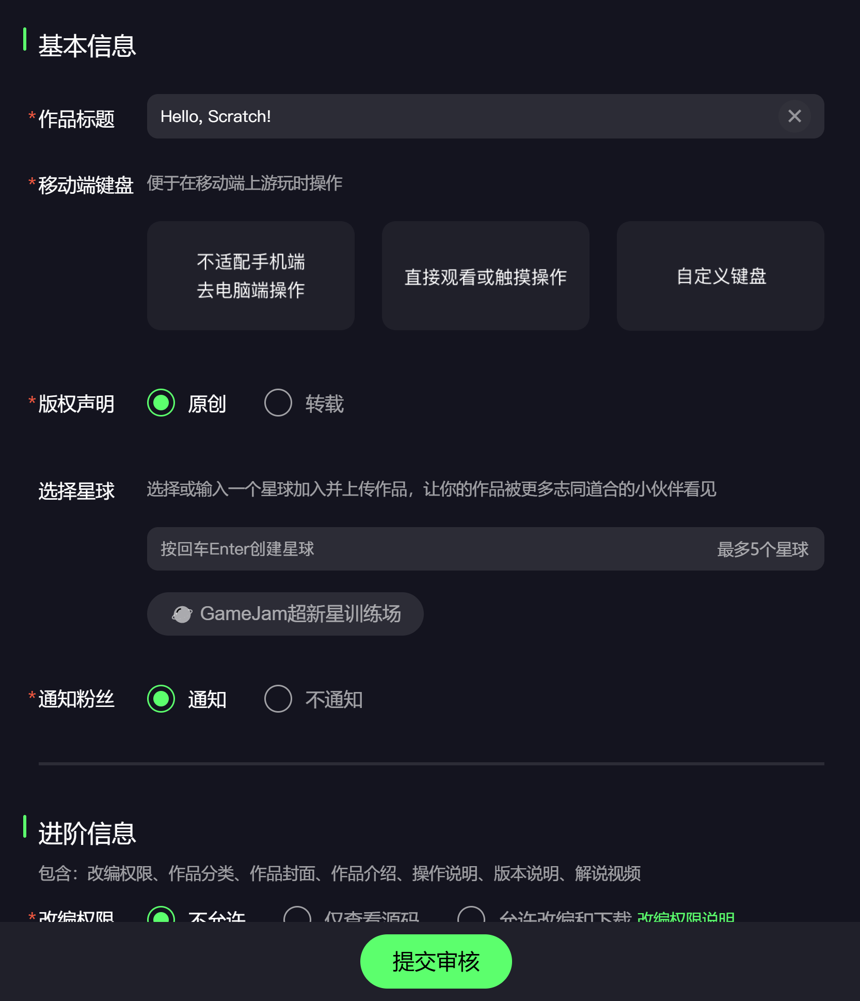
Gandi IDE – Publish Project
Project Title
Work on PC
Submit for Review

Slide 22
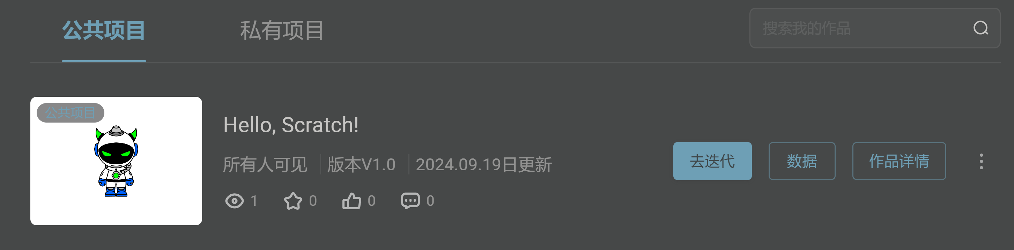
Gandi IDE – Publish Project
Go Iterate
Project Details
New Public Project
Stats

Slide 23
Gandi IDE

Slide 24

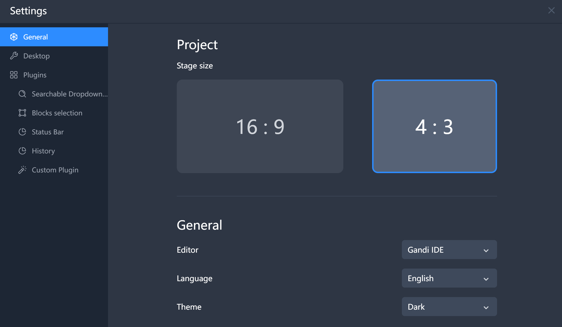
Gandi IDE - Settings
Stage Size
4x3
Language
English

Slide 25
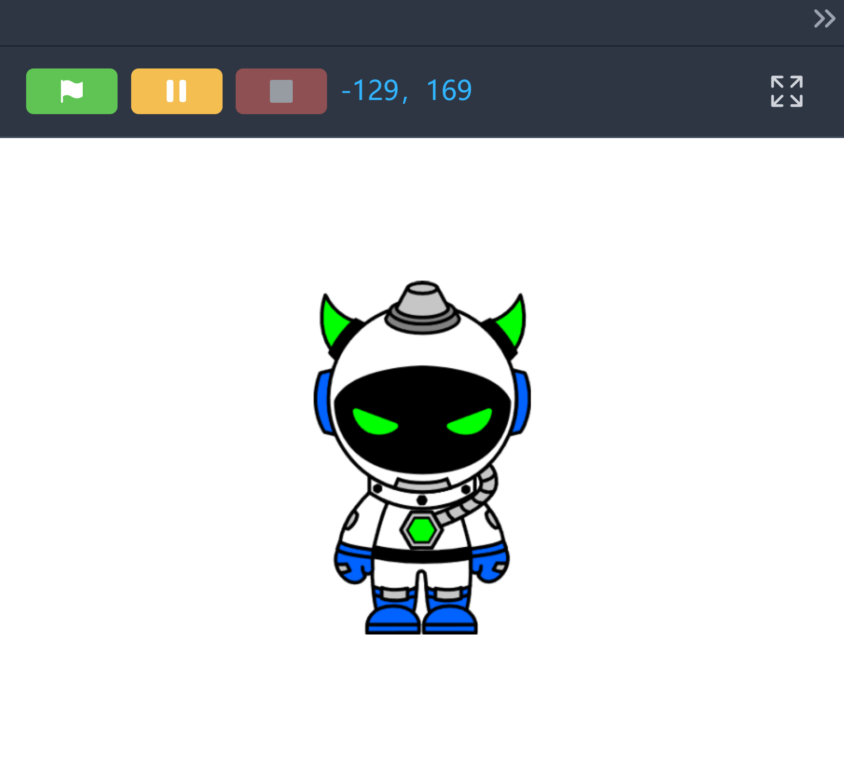
Gandi IDE - Stage
Full Screen
Go
Stop
Pause

Slide 26
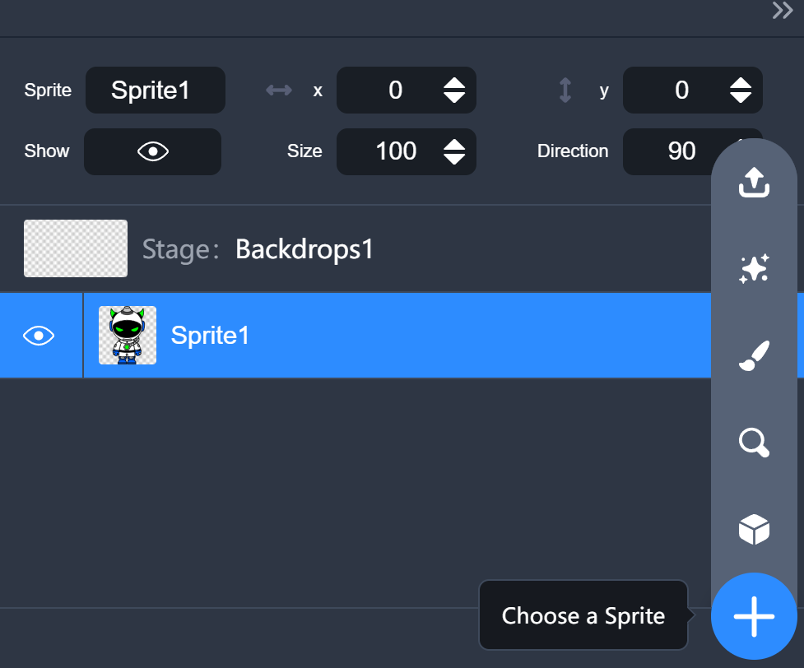
Gandi IDE – Sprite list
Sprite List
Choose a Sprite

Slide 27
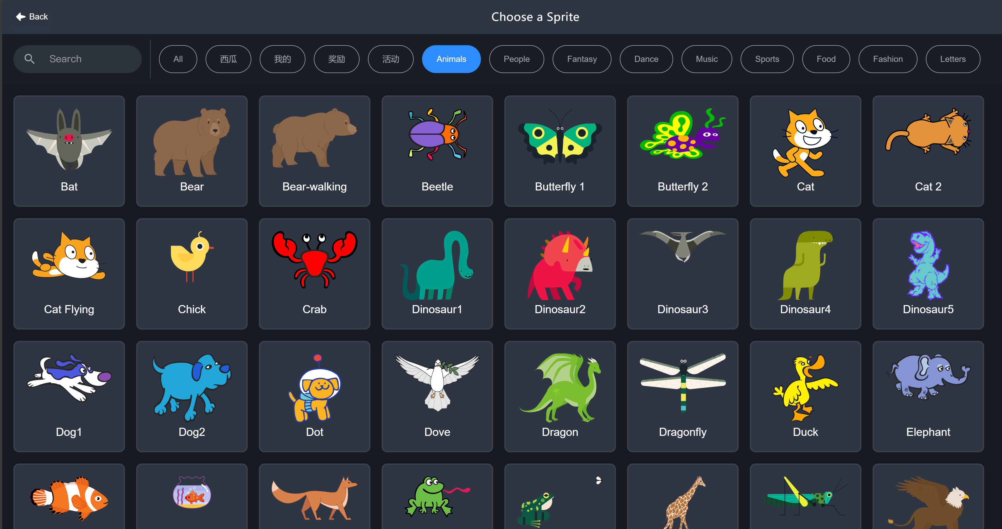
Gandi IDE – Sprite Library

Slide 28
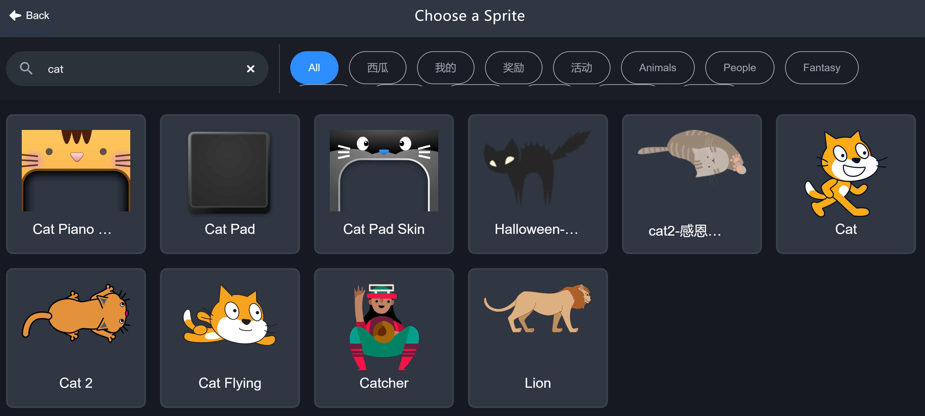
Gandi IDE – Sprite Library
Pick This One!
Search for All Cats

Slide 29
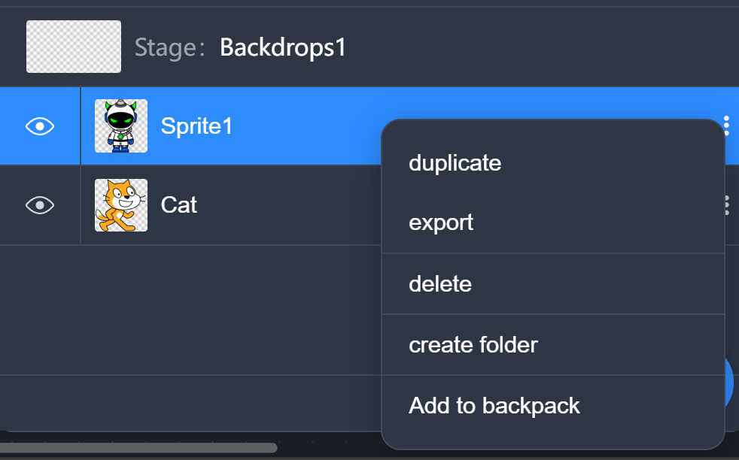
Gandi IDE – Delete sprite
Delete Sprite

Slide 30
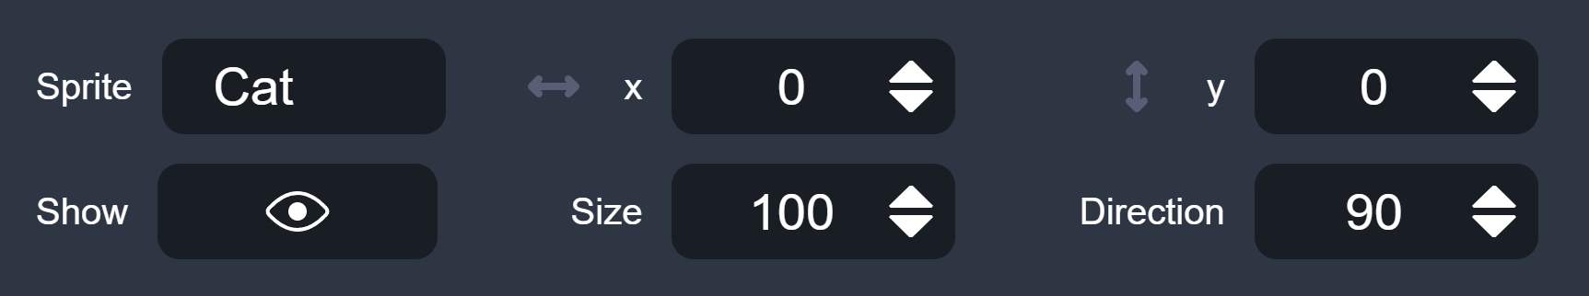
Gandi IDE – sprite Properties

Slide 31

Gandi IDE – Backdrop
Thumbnail
Name

Slide 32
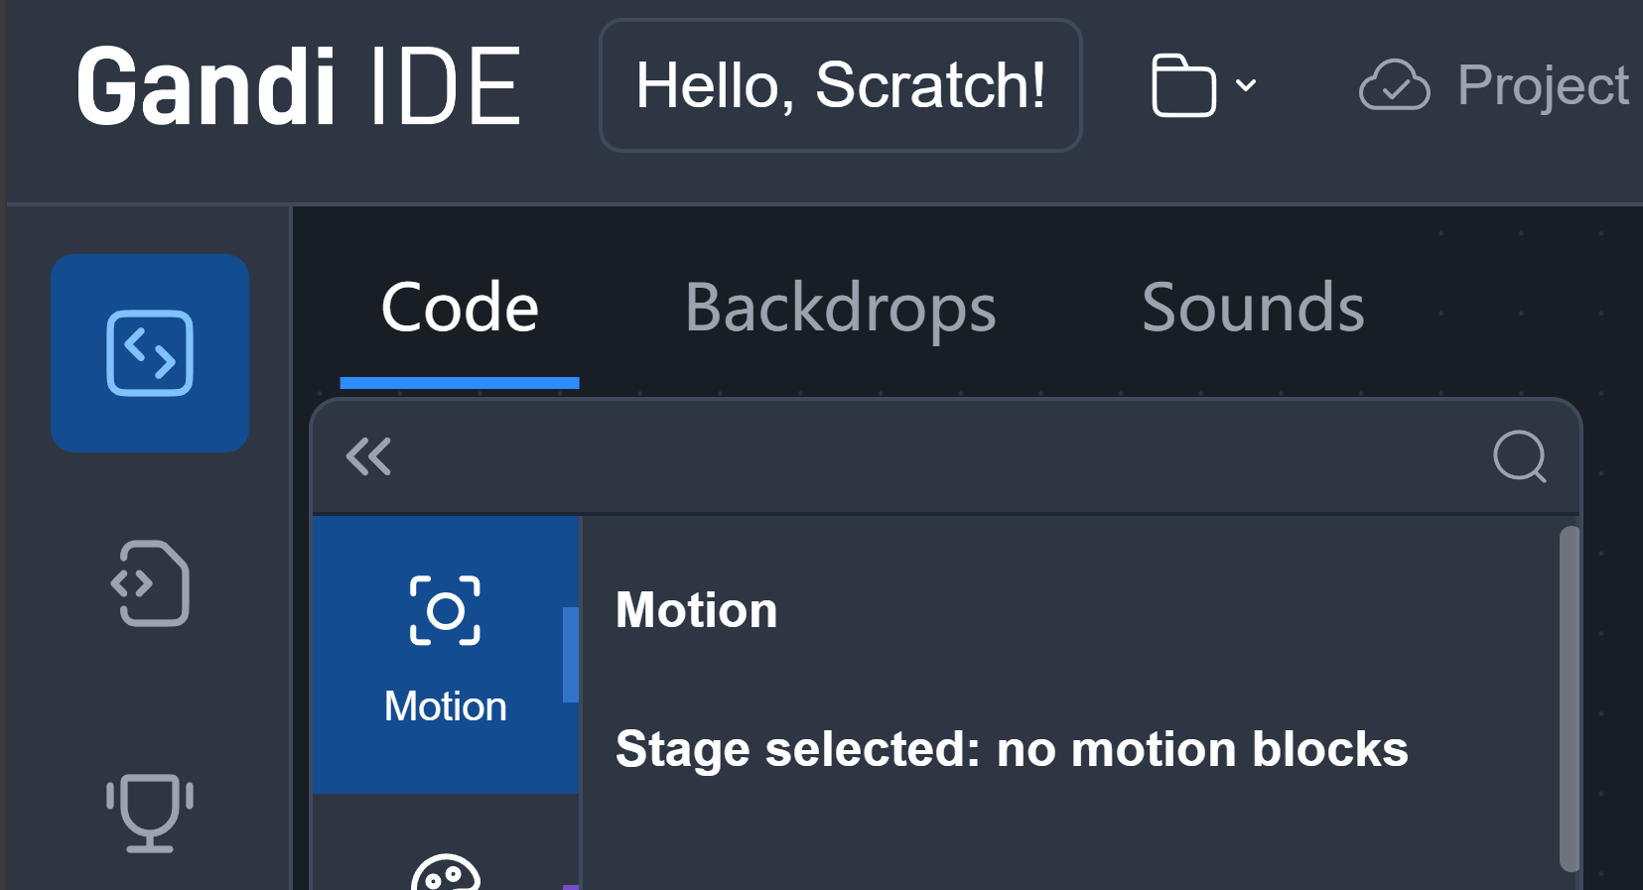
Gandi IDE – Backdrop

Slide 33
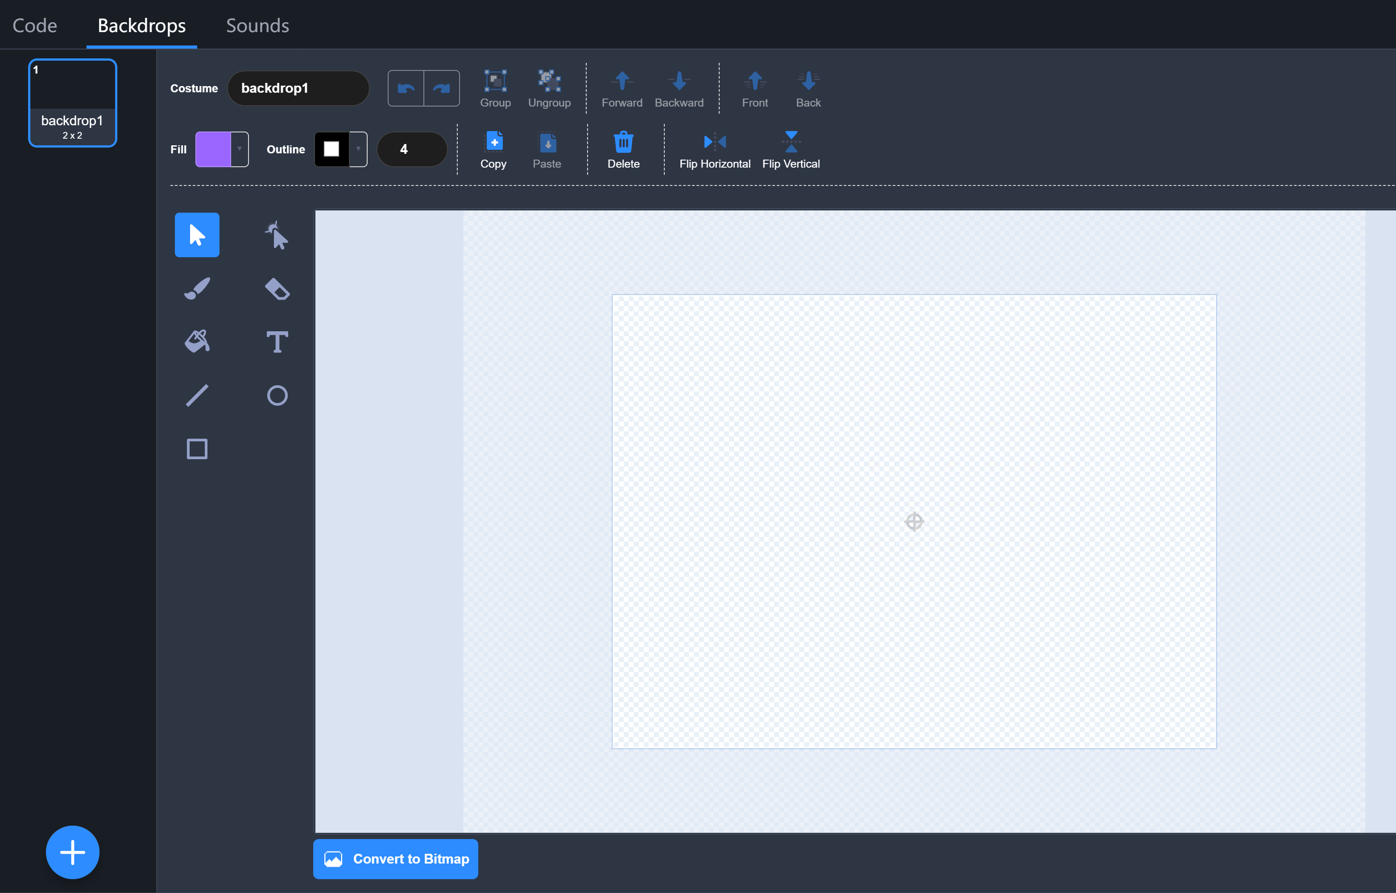
Gandi IDE – Paint editor

Slide 34
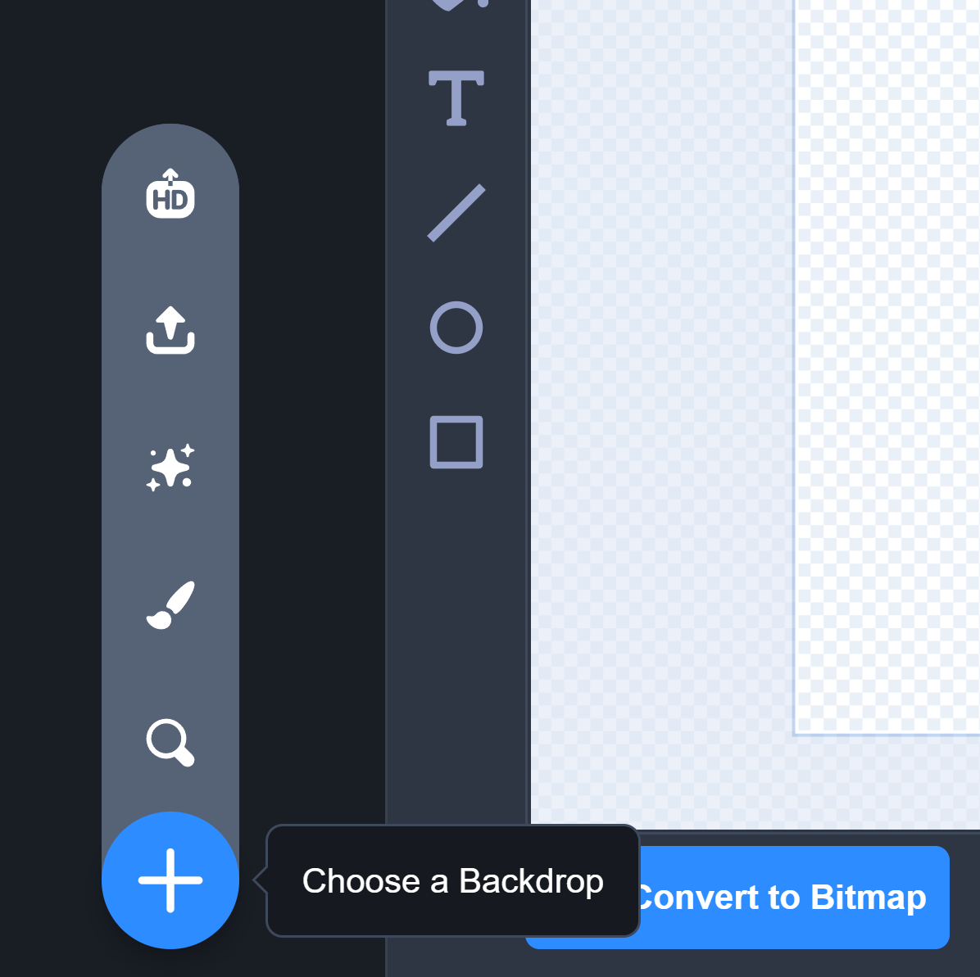
Gandi IDE – Add Backdrop
Add a New Backdrop

Slide 35
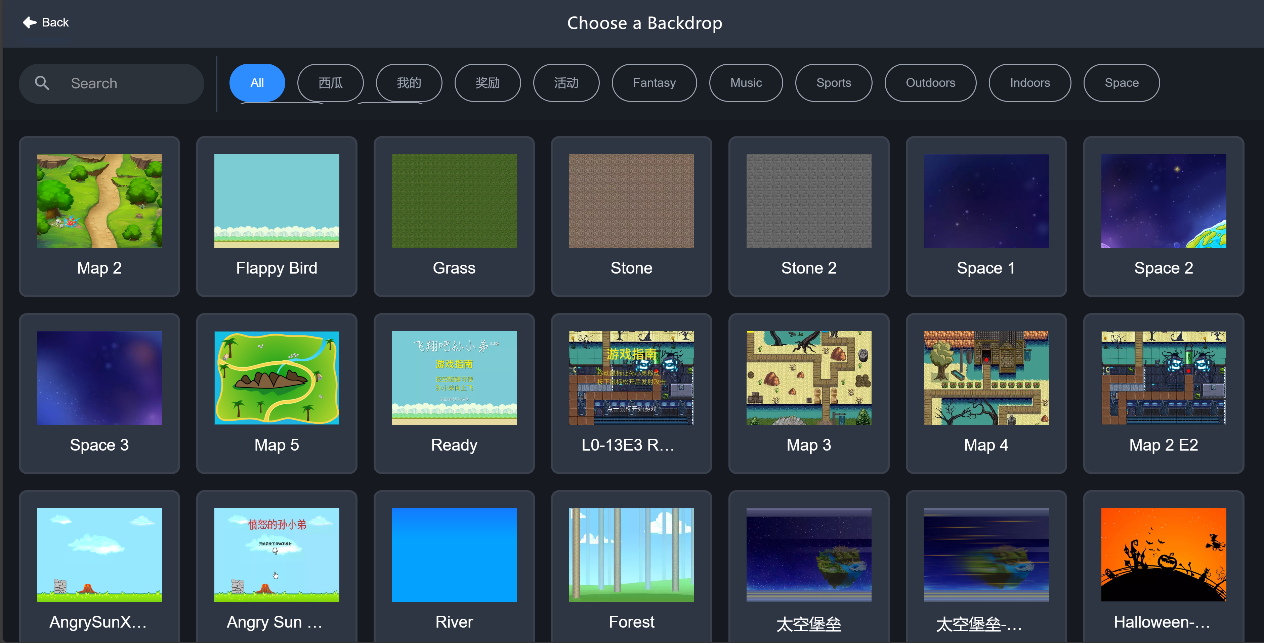
Gandi IDE – Backdrop Library

Slide 36
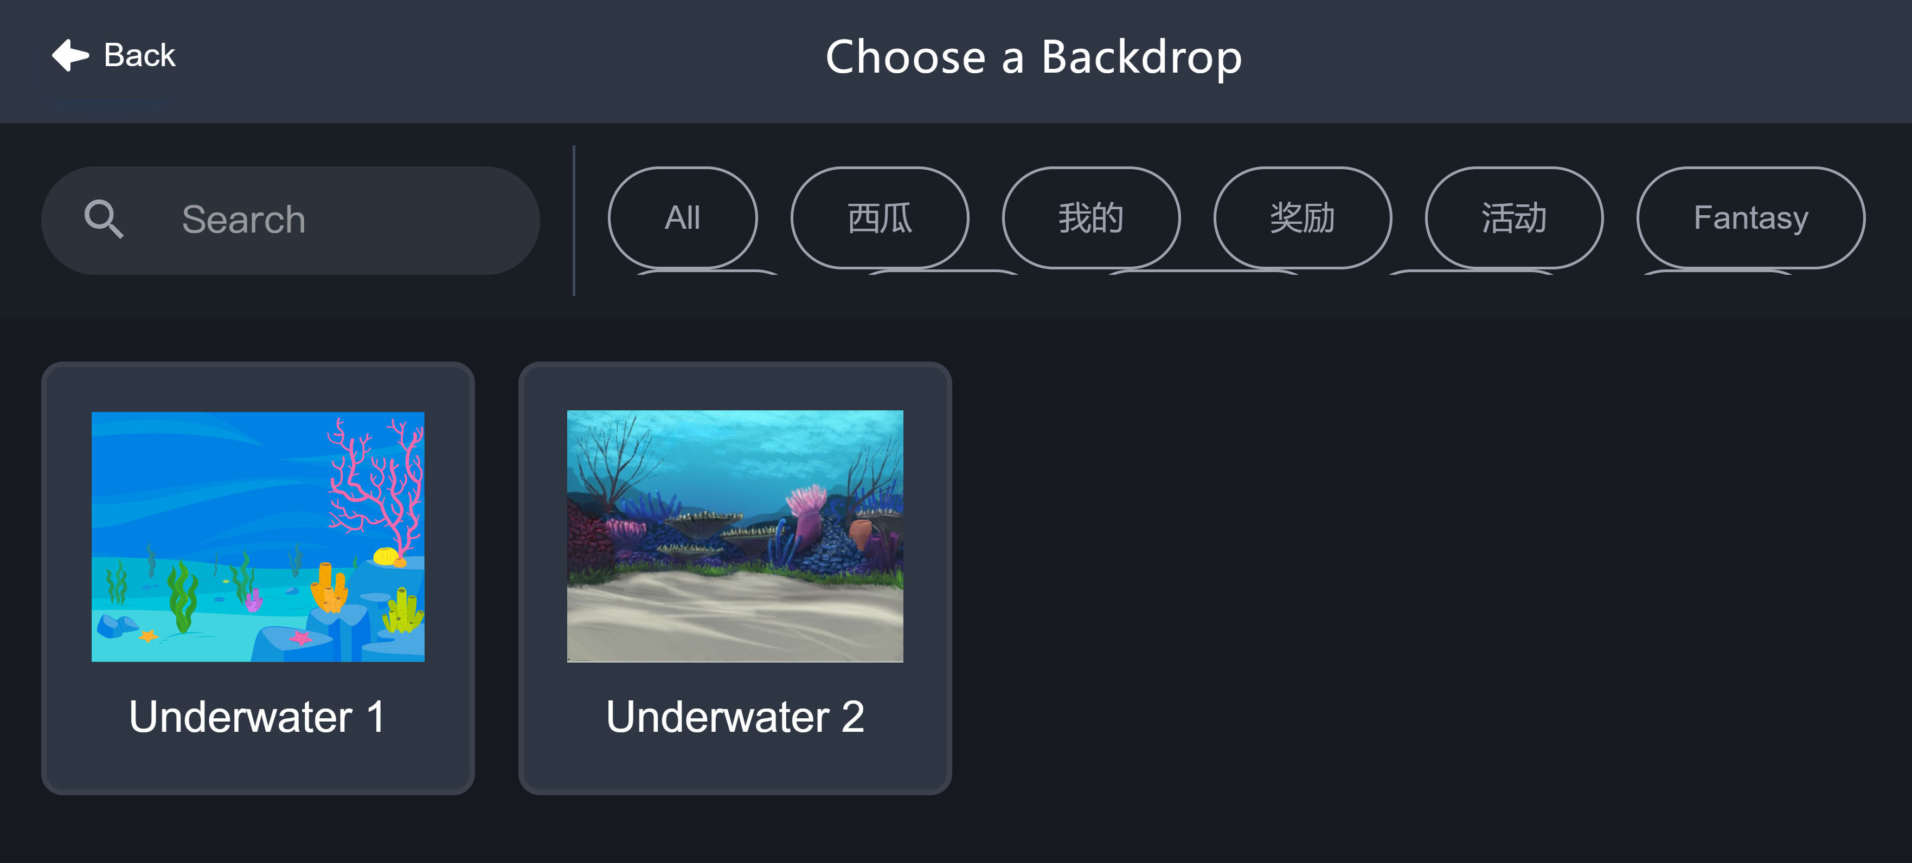
Gandi IDE – Backdrop Library
Add a New Underwater Backdrop

Slide 37
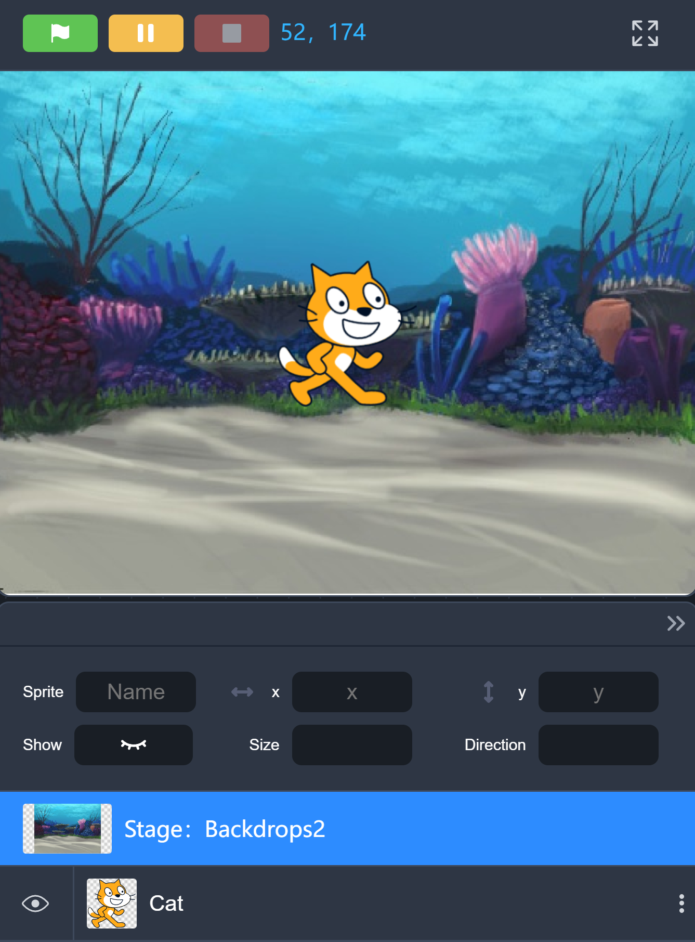
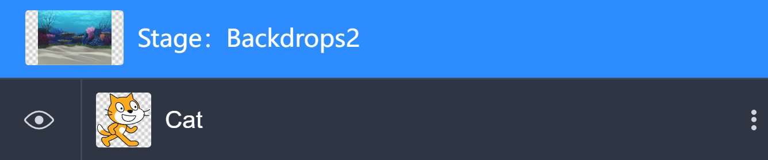
Gandi IDE – New backdrop

Slide 38
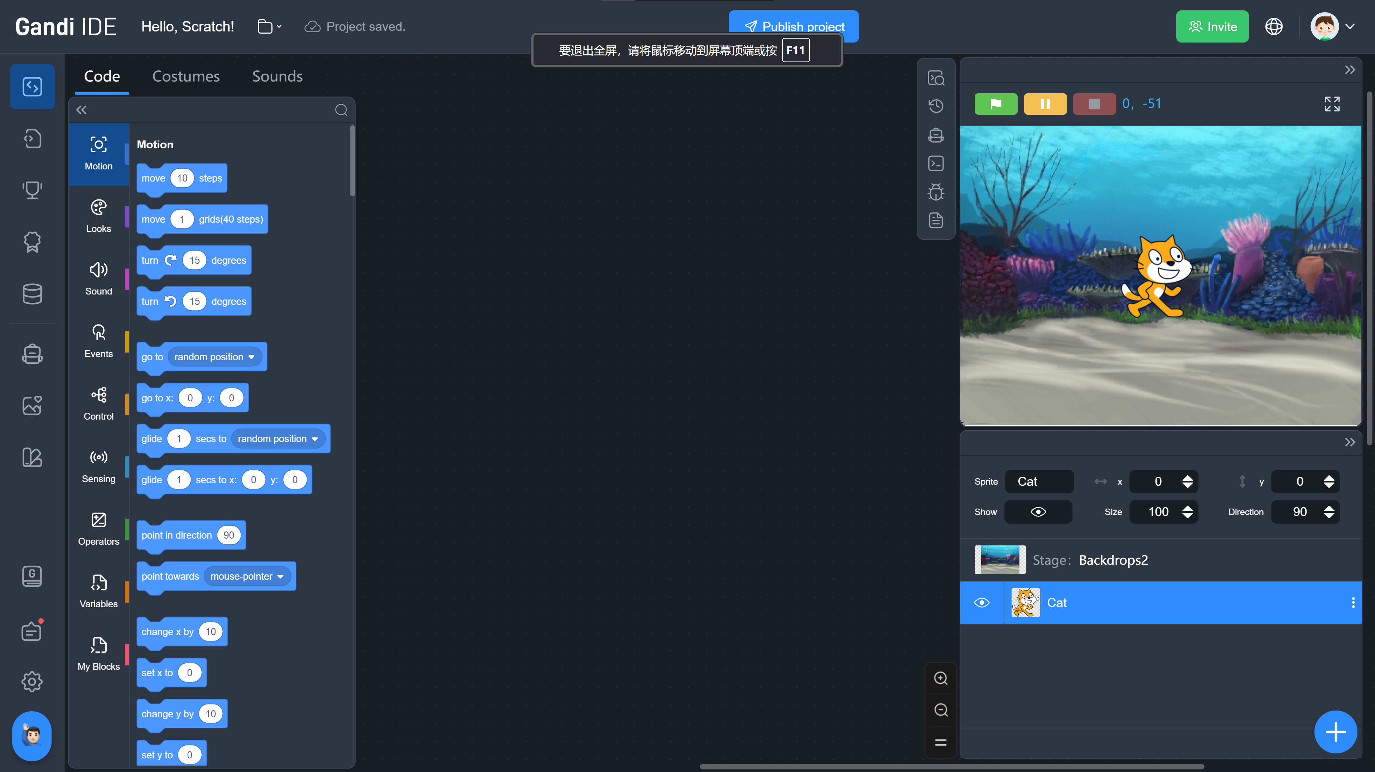
Gandi IDE – Palette

Slide 39
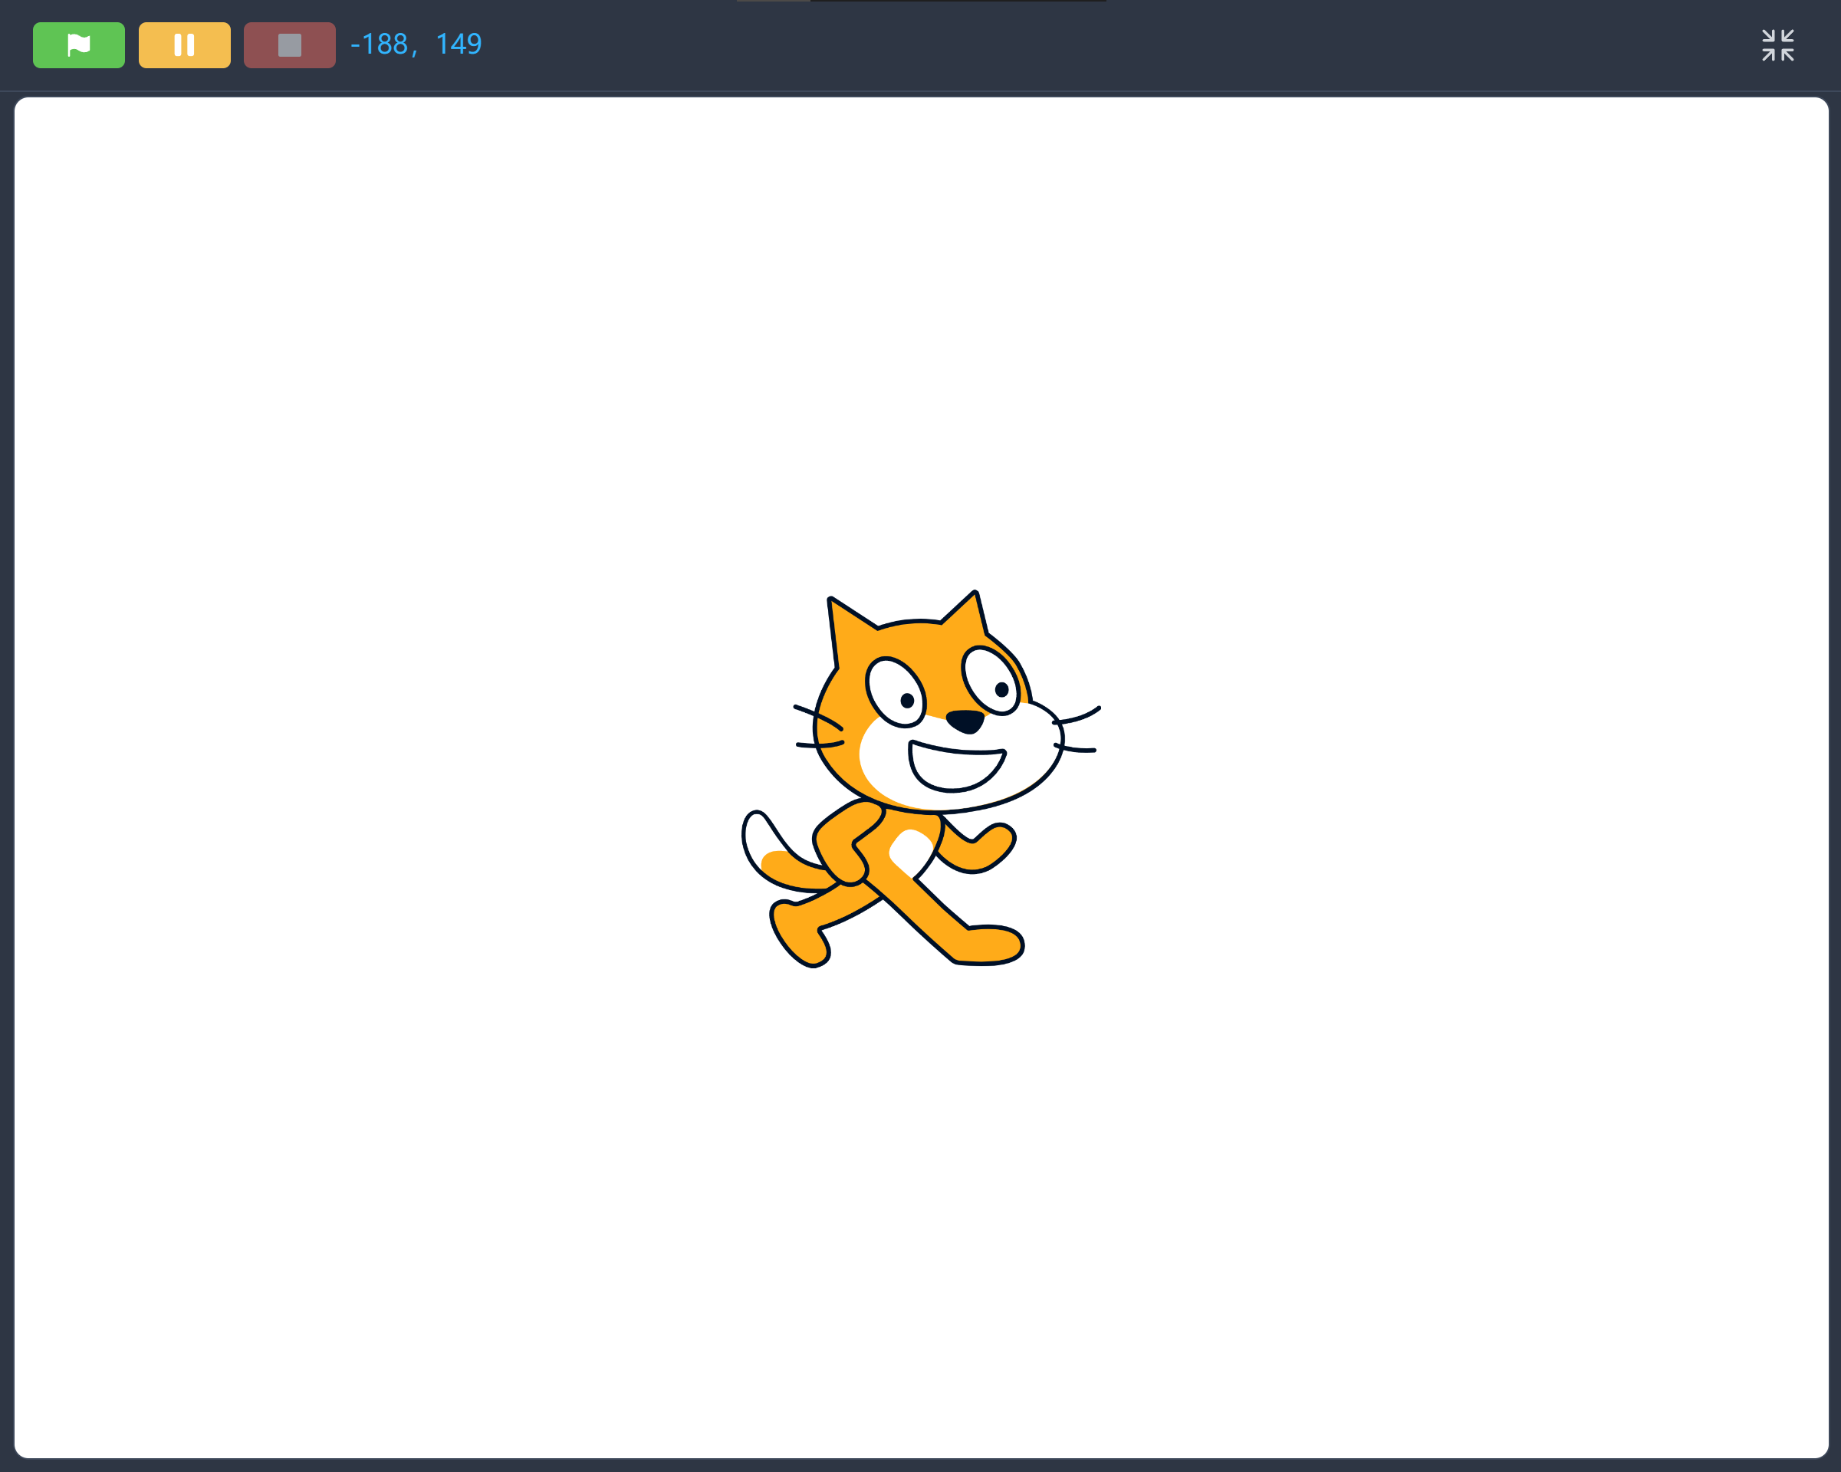
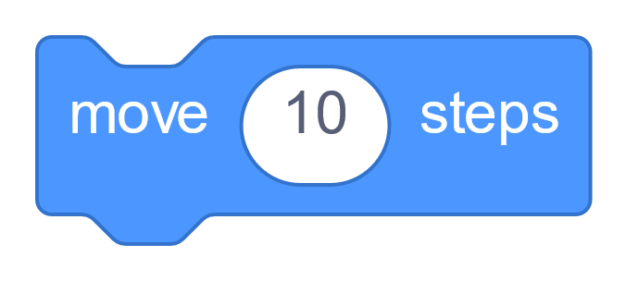
Gandi IDE – Move
Slot

Slide 40
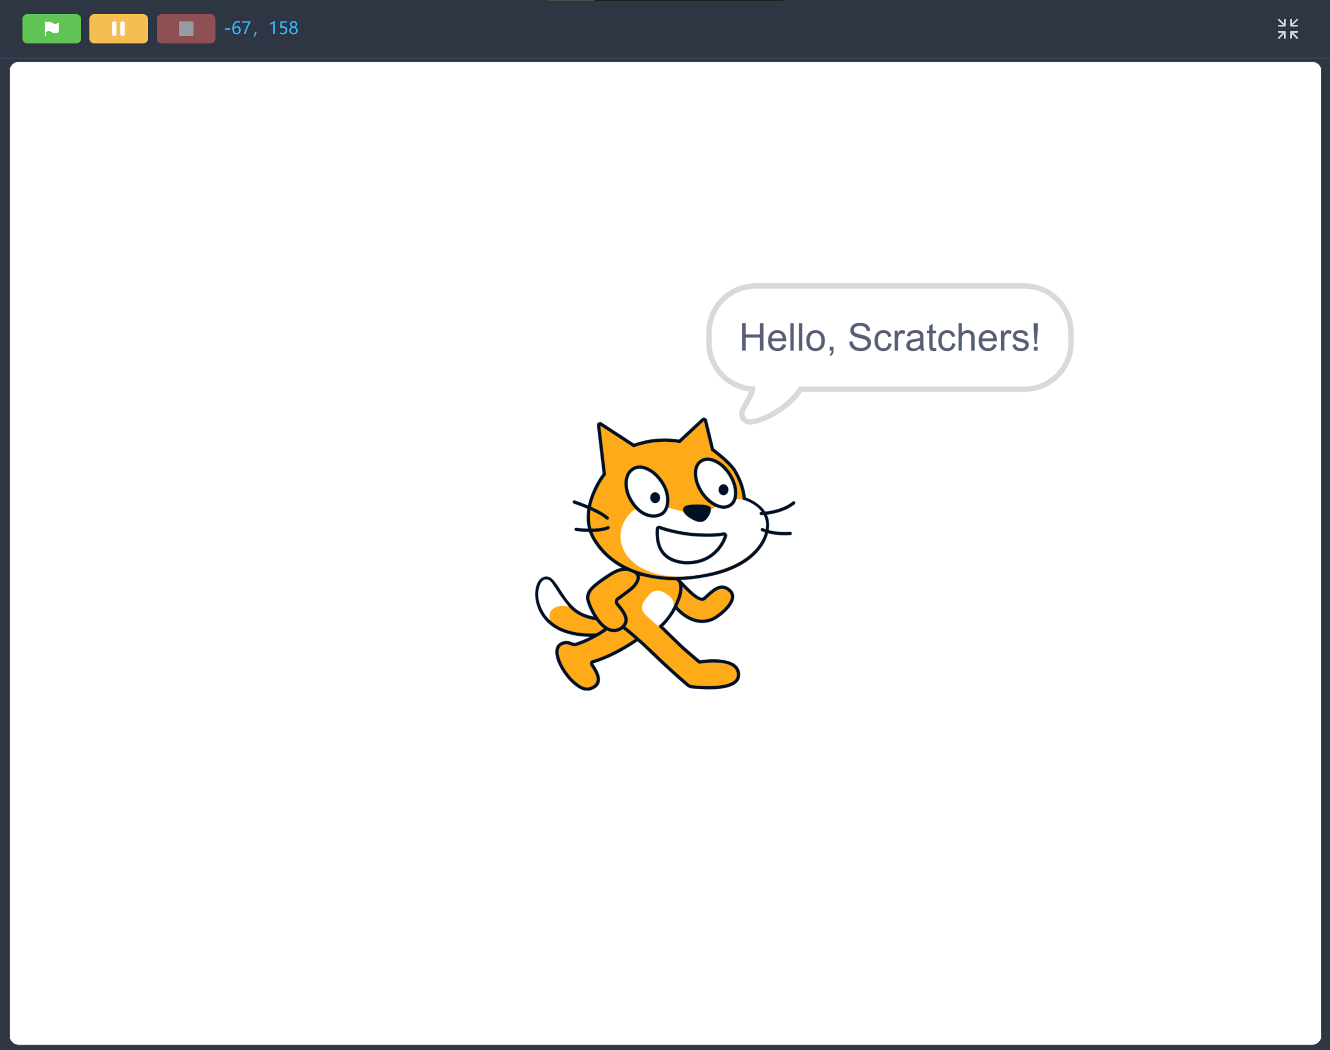
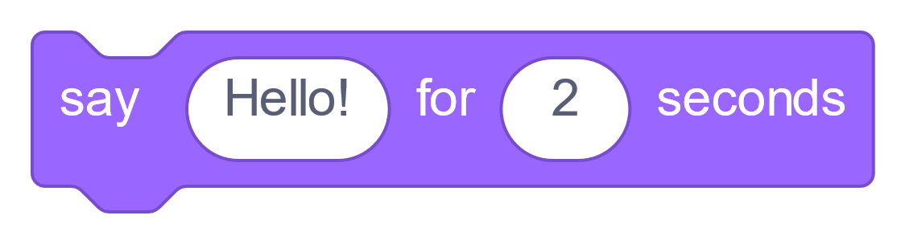
Gandi IDE – say
Slot
Slot

Slide 41
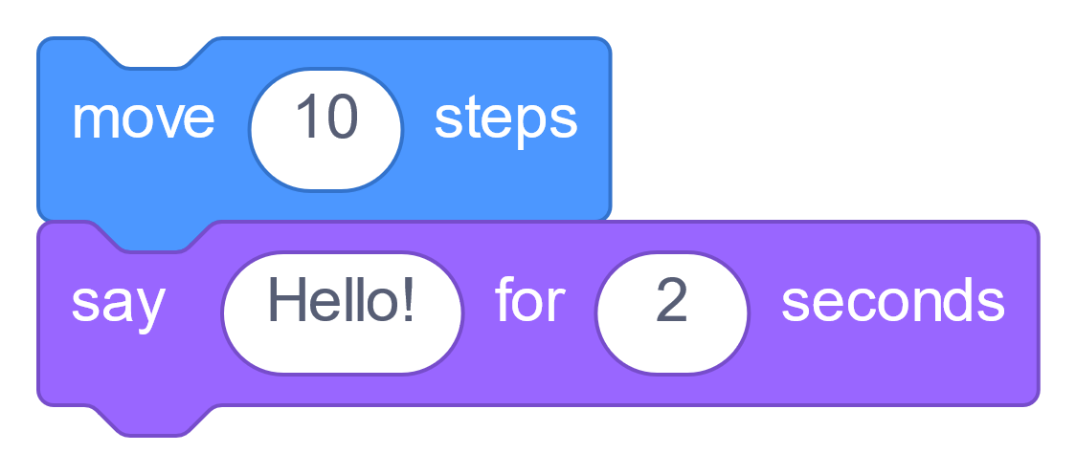
Gandi IDE – move and say

Slide 42
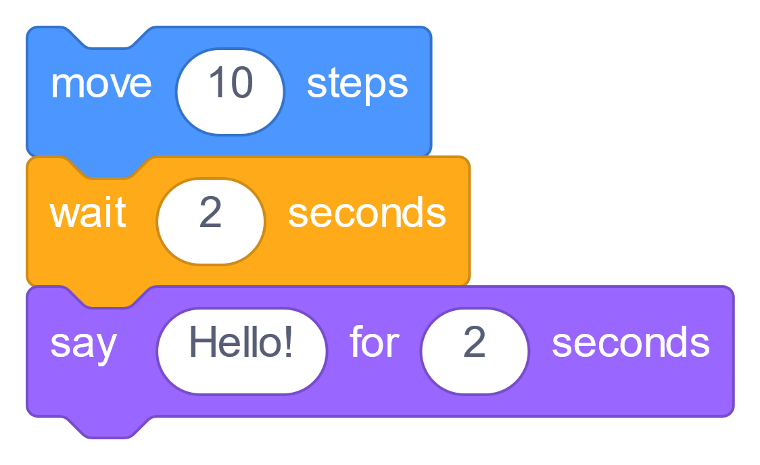
Gandi IDE – move, wait and say

Slide 43
Exercises

